Slide 1
Welcome to CACFP Calculating Ounce Equivalents Training
This training has been updated from the original presentation to include corrections and clarifications. The presentation was re-recorded to include those changes.
To access a recording of the updated presentation, please use the following link: https://us02web.zoom.us/rec/share/W-JYkMcWv9nFJayoxNVeA38QRvFPSan6R0KlvW0bFXYy1ryKZQx8dBIPqjy6lJHC.9KmQyaGDYCPTJ3dA
To get a certificate for completing this training, please see the link at the end of the presentation.
Please note: if you attended the live session, you do not need to get a second certificate for reviewing the updated presentation

Slide 2
Calculating Oz Eq Worksheet
FY22 CACFP Training

Slide 3
Current USDA nondiscrimination statement
In accordance with Federal civil rights law and U.S. Department of Agriculture (USDA) civil rights regulations and policies, the USDA, its Agencies, offices, and employees, and institutions participating in or administering USDA programs are prohibited from discriminating based on race, color, national origin, sex, disability, age, or reprisal or retaliation for prior civil rights activity in any program or activity conducted or funded by USDA.
Persons with disabilities who require alternative means of communication for program information (e.g. Braille, large print, audiotape, American Sign Language, etc.), should contact the Agency (State or local) where they applied for benefits. Individuals who are deaf, hard of hearing or have speech disabilities may contact USDA through the Federal Relay Service at (800) 877-8339. Additionally, program information may be made available in languages other than English.
To file a program complaint of discrimination, complete the USDA Program Discrimination Complaint Form, (AD-3027) found online at: How to File a Complaint, and at any USDA office, or write a letter addressed to USDA and provide in the letter all of the information requested in the form. To request a copy of the complaint form, call (866) 632-9992. Submit your completed form or letter to USDA by:
(1) mail: U.S. Department of Agriculture
Office of the Assistant Secretary for Civil Rights
1400 Independence Avenue, SW
Washington, D.C. 20250-9410;
(2) fax: (202) 690-7442; or
(3) email: program.intake@usda.gov.
This institution is an equal opportunity provider.
3

Slide 4
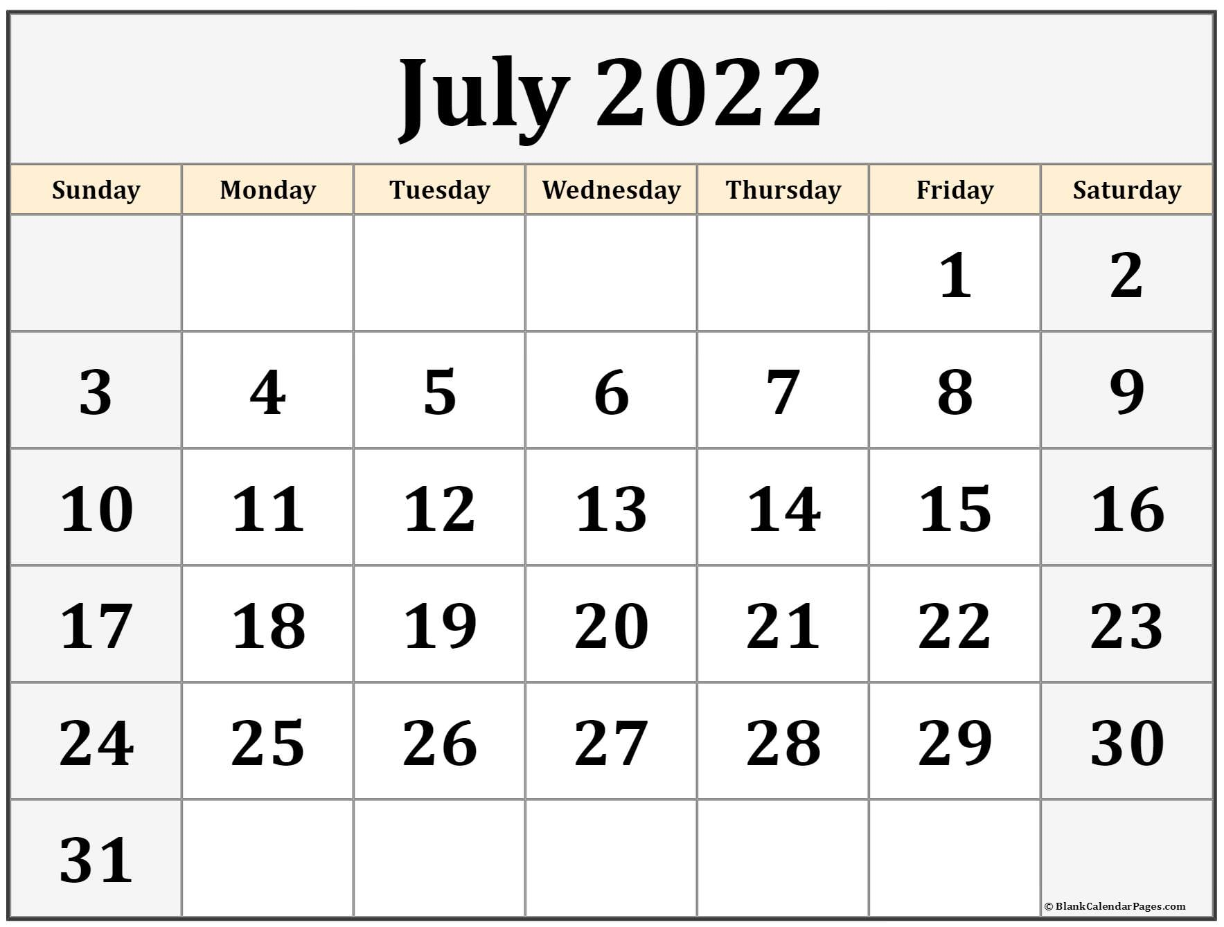
Ounce Equivalents Implementation
USDA has extended a waiver to delay the implementation of ounce equivalents for grains in the CACFP through June 30, 2022
Starting on July 1, 2022, CACFP programs are expected to begin utilizing ounce equivalents for grains
The Document and Reference Library has all previous oz eq trainings

Slide 5
Goal for today
Identify when a center will need to calculate ounce equivalents
Walk through the process for Calculating Ounce Equivalents for Grains worksheet
How to use this form
Examples

Slide 6
When will calculating ounce equivalents be necessary?
01

Slide 7
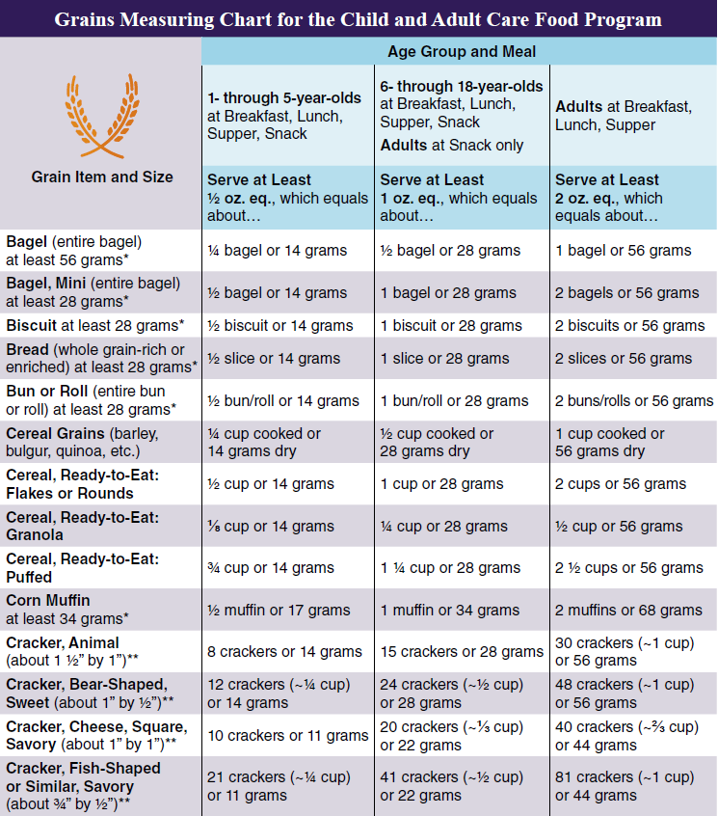
When to calculate ounce equivalents for grains
What if the grain you want to use is:
Not on the worksheet’s Grains Chart?
Lighter than the minimum weight in the grains chart?
Smaller than the minimum size in the grains chart?
Calculating grains in recipes will be addressed in a separate training

Slide 8
Calculating oz eq
Using the Ounce Equivalents Worksheet is a very straightforward method to determine how much of a grain to serve, however any method can be used
Whatever method you prefer and can confidently use for grains will be acceptable!
You don’t need to document your method anywhere, but whoever is determining oz eq should be able to answer questions on their methods, if needed

Slide 9
Using the Calculating Ounce Equivalents Worksheet
02

Slide 10
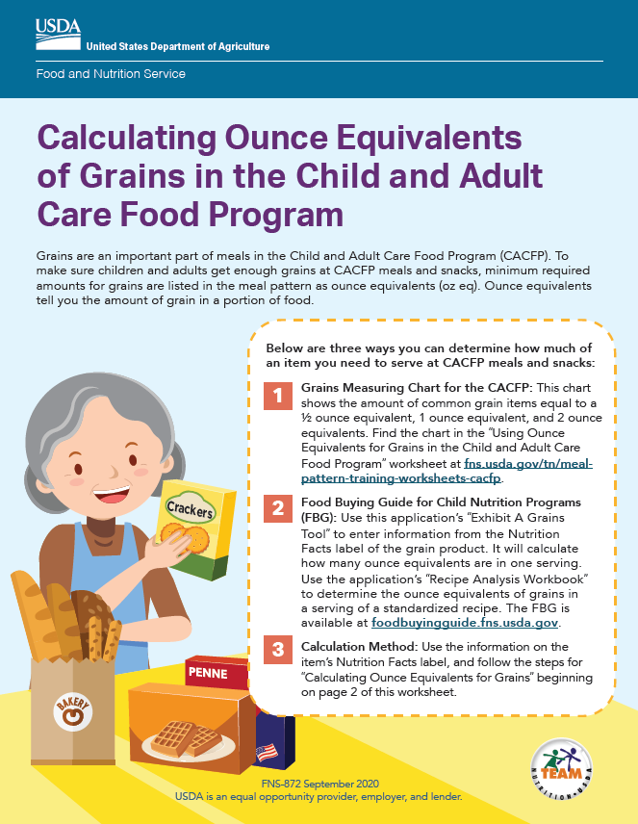
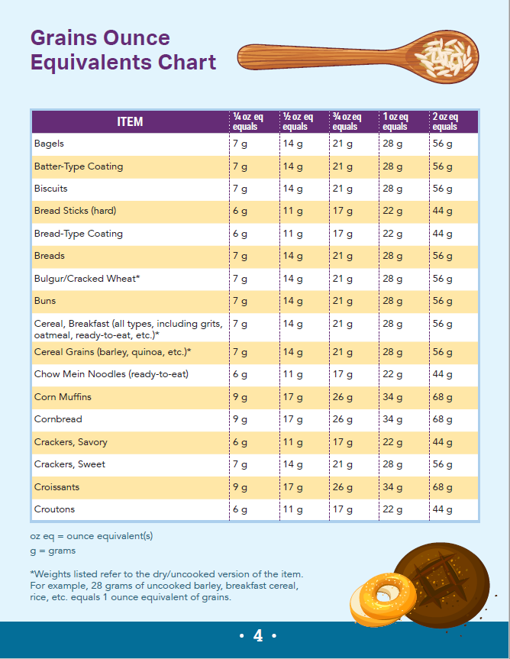
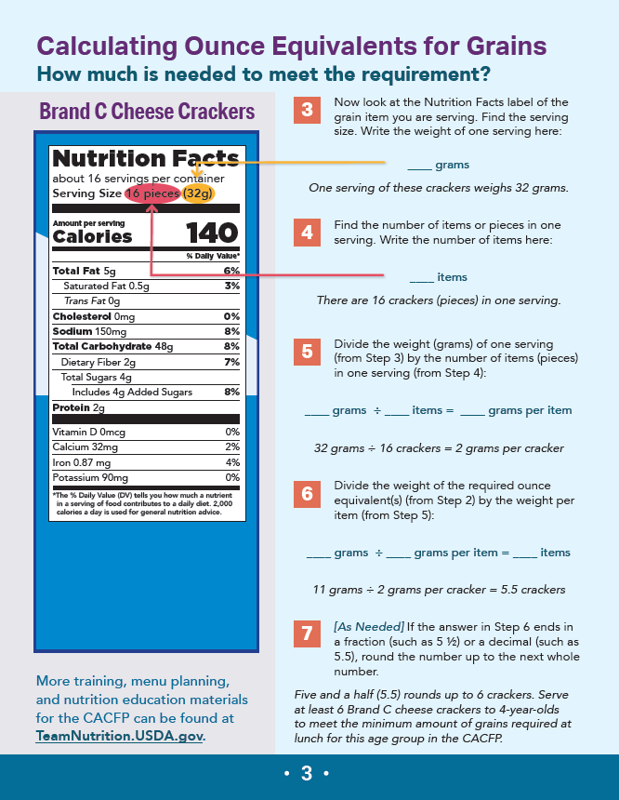
Using Ounce Equivalents in the CACFP Worksheet
See chat for a copy of this worksheet

Slide 11
Using the worksheet
This worksheet will be useful for commonly served grains which may not be appropriate for the ounce equivalents worksheet
Not on the chart
Too small (weight or size) to use the chart
Review your frequently served grain items, identify the amount to be served in ounce equivalents, and keep it with your documentation for your menu planning and shopping
You won’t have to think about it each time

Slide 12
Using the ounce equivalents worksheet
What is the requirement?
Use the chart to find the minimum amount of grains required (in ounce equivalents)
Find the item on the chart and the oz eq.
Find the grain item on the chart and determine what the volume of grains needed (in grams)
Look at the Nutrition Facts Label
Find the serving size
Calculate
Find the number of items/pieces in one serving
Divide the weight (g) of one serving by the number of items in one serving
Divide the weight of the required oz eq by the weight per item
Round up to next whole number

Slide 13
Step 1: What is the requirement?
Determine the minimum amount of grains you need to serve
Age of participant
Age group | Meal | Minimum Amount of Grains Required
Ages 1-5 | Breakfast Lunch/Supper Snack | ½ ounce equivalent
Ages 6-18 | Breakfast Lunch/Supper Snack | 1 ounce equivalent
Adults | Snack | 1 ounce equivalent
Adults | Breakfast Lunch/Supper | 2 ounce equivalents

Slide 14
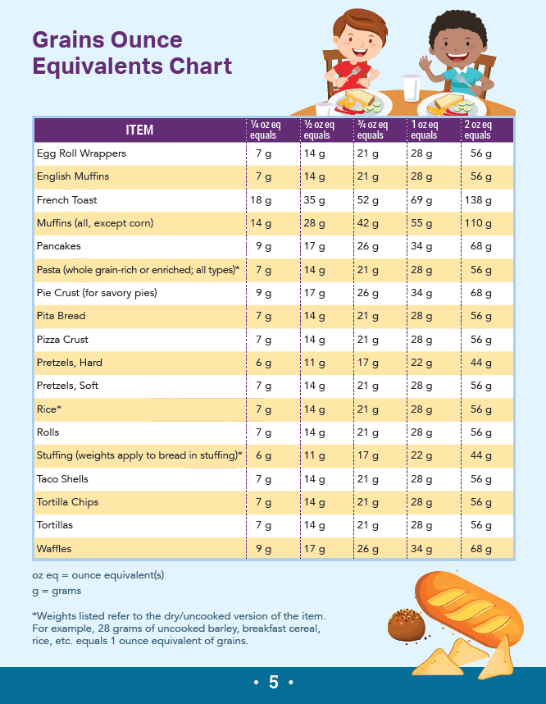
Step 2: Find the grain on the chart

Slide 15
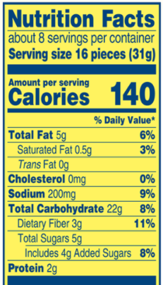
Step 3: Nutrition Facts Label
Find the serving size
Weight of one serving, in grams
Find the number of items/pieces in one serving
Number of items in serving
Weight of one serving, in grams
31 grams
Number of items in serving
16 pieces

Slide 16
Step 4: Calculate
Divide the weight (g) of one serving by the number of items/pieces in one serving
31g/16 pieces= 1.9375g/piece
Divide weight of required oz eq by weight per item
Will vary by grain and age group

Slide 17
Examples
03

Slide 18
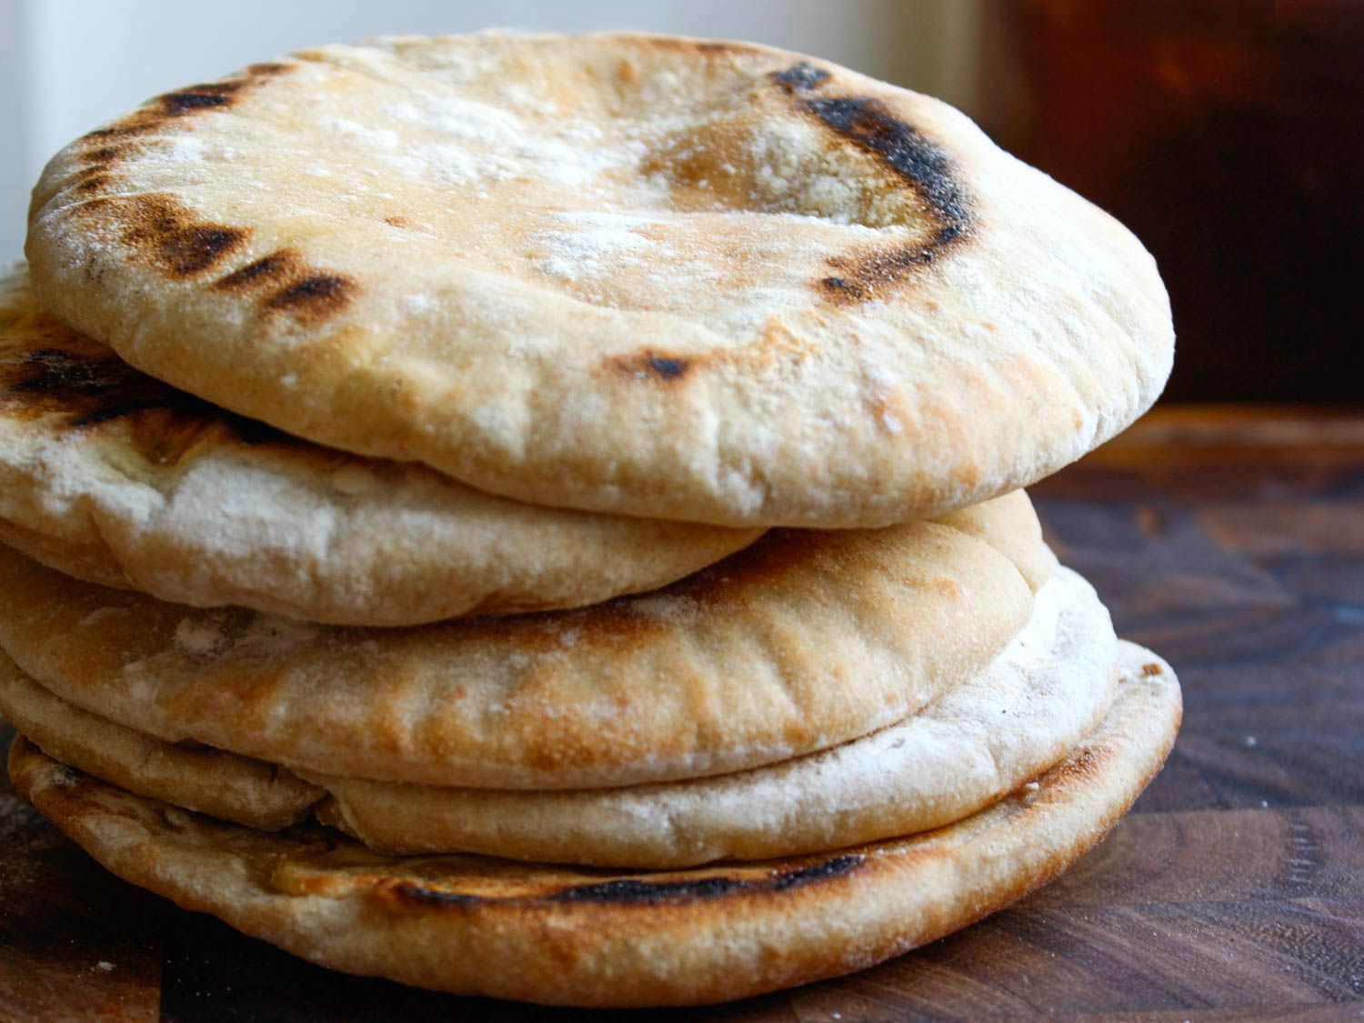
Example 1: Pita bead
DESE’s Afterschool Program is serving pita bread with hummus for a snack to their afterschool classroom (ages 6-11)
Pita bread they purchased does not meet minimum weight to use other oz eq worksheet
How much will they need to serve?

Slide 19
Step 1: What is the requirement?
How much does the center need to offer?
Age group | Meal | Minimum Amount of Grains Required
Ages 1-5 | Breakfast Lunch/Supper Snack | ½ ounce equivalent
Ages 6-18 | Breakfast Lunch/Supper Snack | 1 ounce equivalent
Adults | Snack | 1 ounce equivalent
Adults | Breakfast Lunch/Supper | 2 ounce equivalents

Slide 20
Step 1: What is the requirement?
How much does the center need to offer??
Age group | Meal | Minimum Amount of Grains Required
Ages 1-5 | Breakfast Lunch/Supper Snack | ½ ounce equivalent
Ages 6-18 | Breakfast Lunch/Supper Snack | 1 ounce equivalent
Adults | Snack | 1 ounce equivalent
Adults | Breakfast Lunch/Supper | 2 ounce equivalents

Slide 21
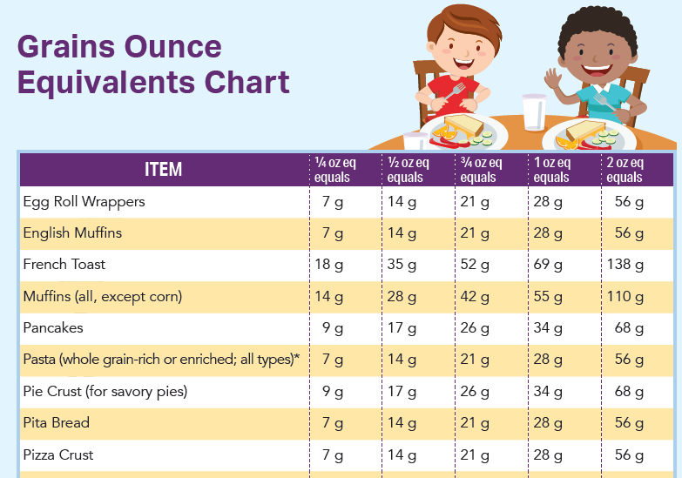
Step 2: Find the item on the chart

Slide 22
Step 2: Find the item on the chart
One (1) oz equivalent for pita bread is 28g

Slide 23
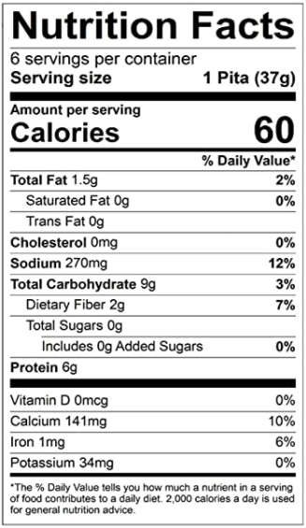
Step 3: Nutrition Facts Label
Find the serving size
Weight of one serving, in grams
37grams
Find the number of items/pieces in one serving
Number of items in serving
1 pita per serving

Slide 24
Step 4: Calculate
Divide the weight (g) of one serving by the number of items/pieces in one serving
37g/1 pita per serving= 37g/serving
Divide the weight of the required oz eq by the weight per item

Slide 25
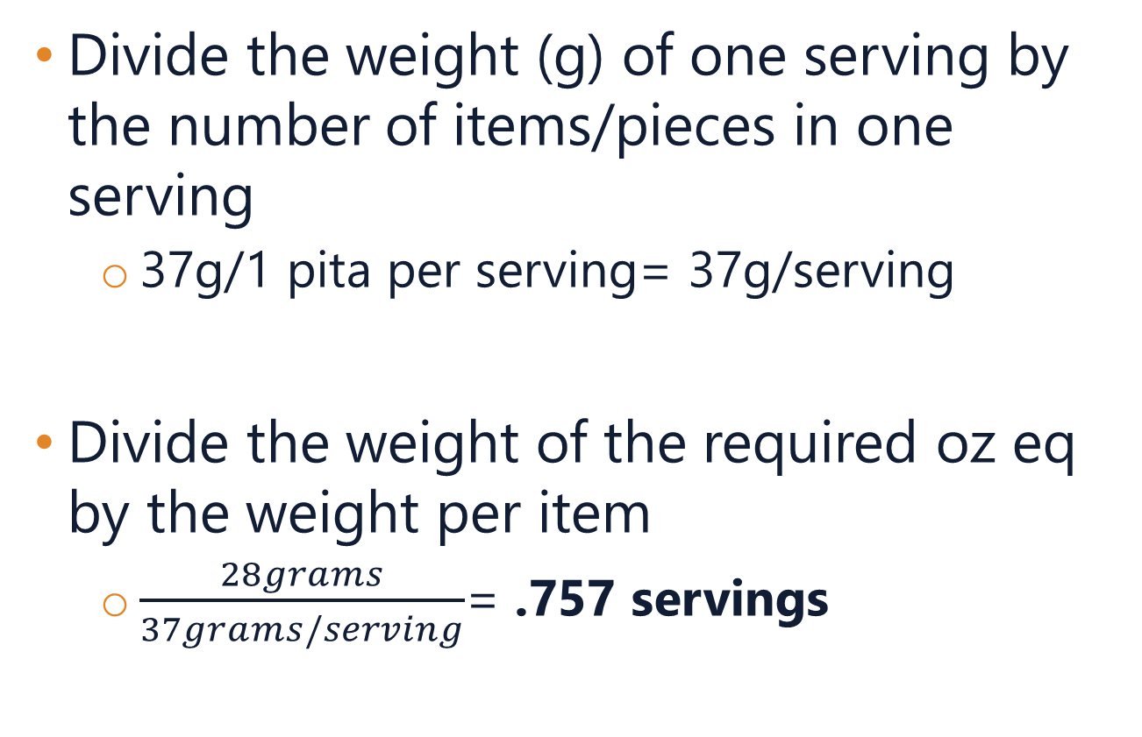
Step 4: Calculate
Divide the weight (g) of one serving by the number of items/pieces in one serving
37g/1 pita per serving= 37g/serving
Divide the weight of the required oz eq by the weight per item
$\frac{28grams}{37grams/serving}$= .757 servings

Slide 26
Step 5 (option): Rounding
If the result of the final calculation is a fraction of an item, program can round up to the next whole number
This is the method outlined in the handout
For certain items, it may be possible to easily divide or portion an item into pieces, like ¼, ½, ¾
For items where it is challenging to divide up (i.e., a cracker, hard pretzels, taco shells, etc.) round up to the next whole item number
In this example, would need to offer at least ¾ of this pita, but can round up to 1 whole pita

Slide 27
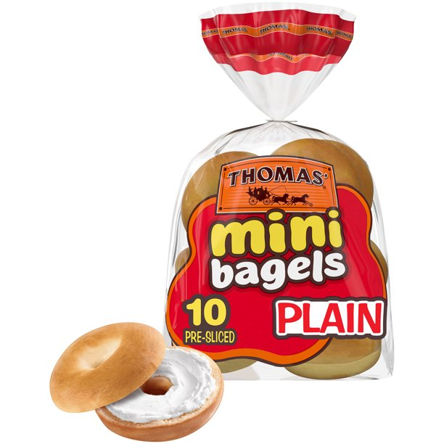
Example 2: Bagels
FNP’s Adult Day Health center is serving a breakfast of mini bagels with fruit salad, yogurt, and coffee/tea.
How many mini bagels will they need to offer to meet the minimum amount in ounce equivalents?

Slide 28
Step 1: What is the requirement?
How much does the center need to offer?
Age group | Meal | Minimum Amount of Grains Required
Ages 1-5 | Breakfast Lunch/Supper Snack | ½ ounce equivalent
Ages 6-18 | Breakfast Lunch/Supper Snack | 1 ounce equivalent
Adults | Snack | 1 ounce equivalent
Adults | Breakfast Lunch/Supper | 2 ounce equivalents

Slide 29
Step 1: What is the requirement?
How much does the center need to offer??
Age group | Meal | Minimum Amount of Grains Required
Ages 1-5 | Breakfast Lunch/Supper Snack | ½ ounce equivalent
Ages 6-18 | Breakfast Lunch/Supper Snack | 1 ounce equivalent
Adults | Snack | 1 ounce equivalent
Adults | Breakfast Lunch/Supper | 2 ounce equivalents

Slide 30
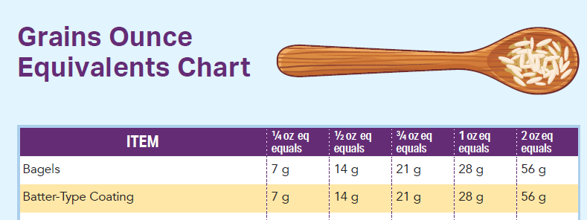
Step 2: Find the item on the chart

Slide 31
Step 2: Find the item on the chart
Two (2) oz equivalents for bagels are 56g

Slide 32
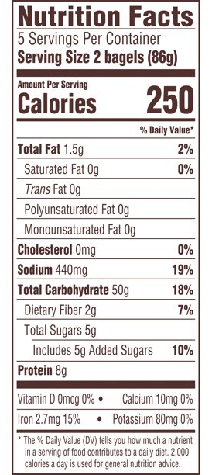
Step 3: Nutrition Facts Label
Find the serving size
Weight of one serving, in grams
86 grams
Find the number of items/pieces in one serving
Number of items in serving
2 bagels per one serving

Slide 33
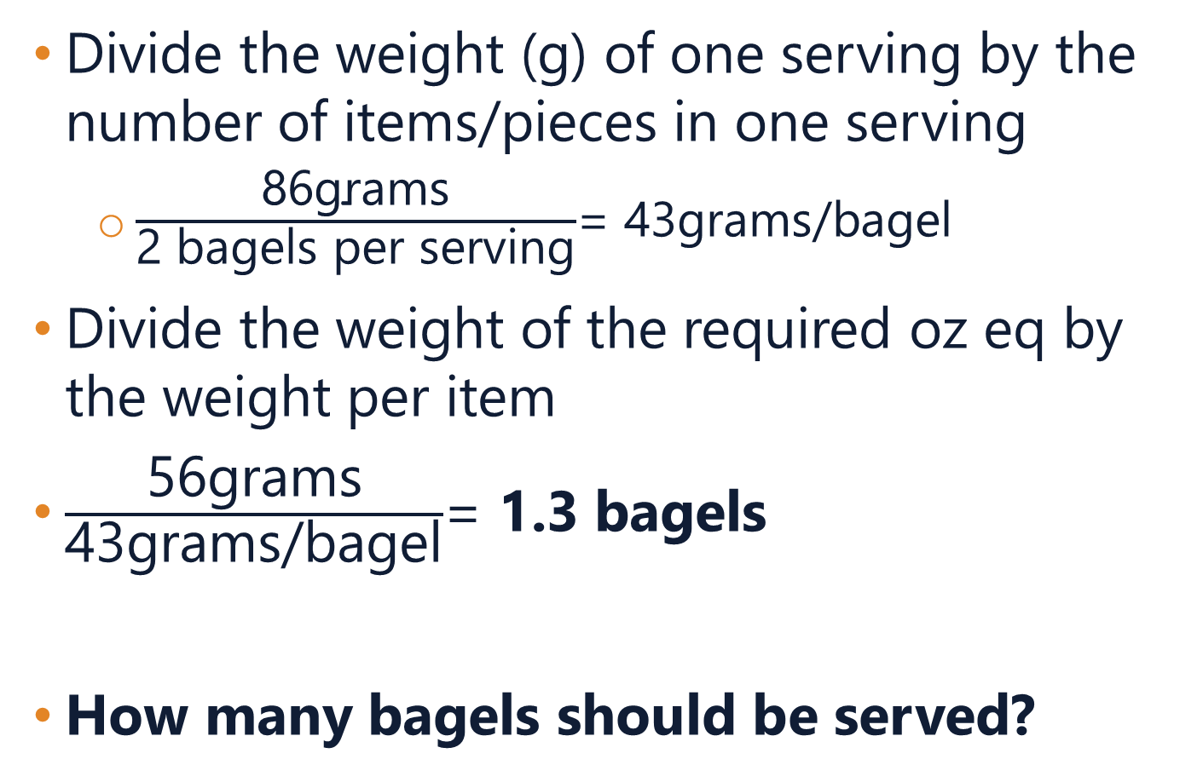
Step 4: Calculate
Divide the weight (g) of one serving by the number of items/pieces in one serving
$\frac{\text{86}\text{grams}}{\text{2 }\text{bagels} \text{per} \text{serving}}$= 43grams/bagel
Divide the weight of the required oz eq by the weight per item
$\frac{\text{56}\text{grams}}{\text{43}\text{grams}\text{/}\text{bagel}}$= 1.3 bagels
How many bagels should be served?

Slide 34
Step 5 (option): Rounding
Since these are mini bagels, portioning out about .3 of a mini bagel would be challenging
Recommend that the program round up to 2 mini bagels to ensure minimum portion size is met

Slide 35
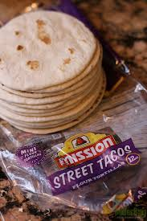
Example 3: Tacos
DESE’s Family Day Care Home is serving tacos to their kids, ages 2-4
The provider is using street taco-sized tortillas, which are easier for the younger kids to handle
Street tacos are 4.5” across, and therefore are too small to use the other ounce equivalent worksheet

Slide 36
Step 1: What is the requirement?
How much does the center need to offer?
Age group | Meal | Minimum Amount of Grains Required
Ages 1-5 | Breakfast Lunch/Supper Snack | ½ ounce equivalent
Ages 6-18 | Breakfast Lunch/Supper Snack | 1 ounce equivalent
Adults | Snack | 1 ounce equivalent
Adults | Breakfast Lunch/Supper | 2 ounce equivalents

Slide 37
Step 1: What is the requirement?
How much does the center need to offer?
Age group | Meal | Minimum Amount of Grains Required
Ages 1-5 | Breakfast Lunch/Supper Snack | ½ ounce equivalent
Ages 6-18 | Breakfast Lunch/Supper Snack | 1 ounce equivalent
Adults | Snack | 1 ounce equivalent
Adults | Breakfast Lunch/Supper | 2 ounce equivalents

Slide 38
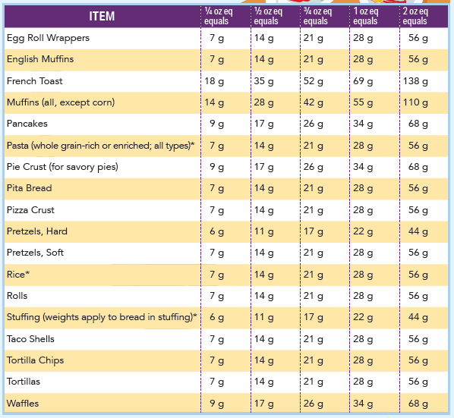
Step 2: Find the item on the chart

Slide 39
Step 2: Find the item on the chart
½ ounce equivalent for tortillas is 14 grams

Slide 40
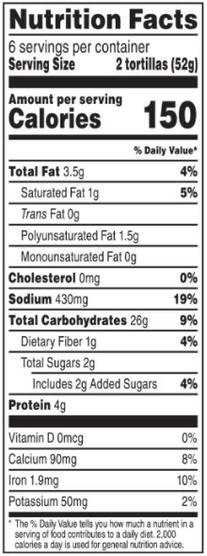
Step 3: Nutrition Facts Label
Find the serving size
Weight of one serving, in grams
52 grams
Find the number of items/pieces in one serving
Number of items in serving
2 tortillas per serving

Slide 41
Step 4: Calculate
Divide the weight (g) of one serving by the number of items/pieces in one serving
Divide the weight of the required oz eq by the weight per item
How many tortillas must be served?

Slide 42
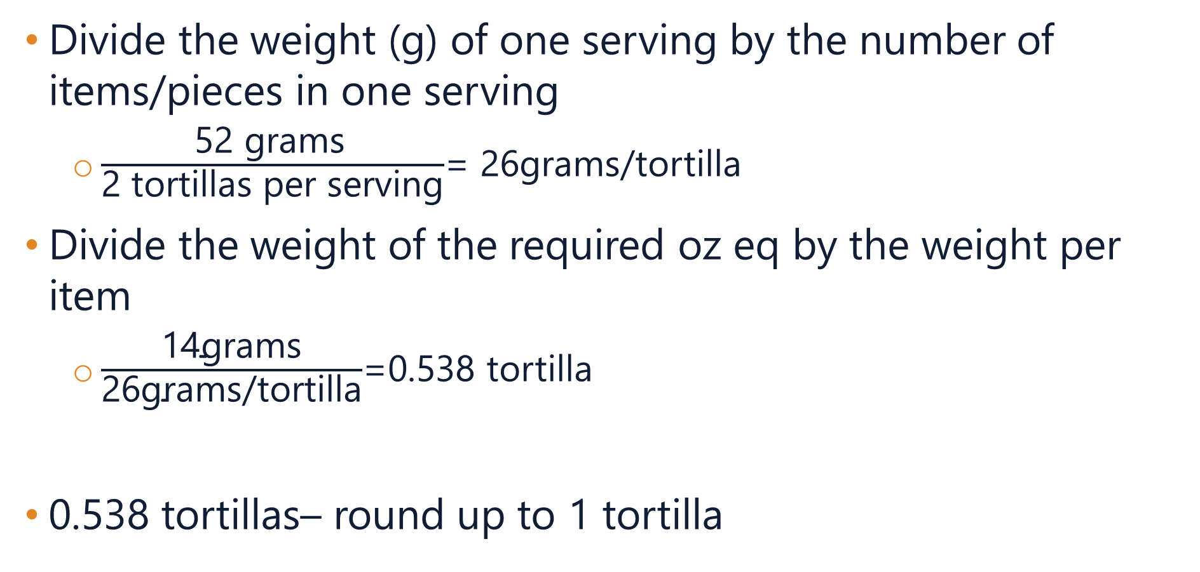
Step 4: Calculate
Divide the weight (g) of one serving by the number of items/pieces in one serving
$\frac{\text{52 }\text{g}\text{rams} }{\text{2 }\text{tortillas} \text{per} \text{serving}}$= 26grams/tortilla
Divide the weight of the required oz eq by the weight per item
$\frac{\text{14}\text{grams}}{\text{26}\text{grams}\text{/}\text{tortilla}}$=0.538 tortilla
0.538 tortillas– round up to 1 tortilla

Slide 43
What if my grain is different?
03

Slide 44
What if my grain is different?
What if the grain you want to use is:
Not on the worksheet’s Grains Chart?
No nutrition facts label available?
You’ll need to use another method to understand how much to serve to meet the meal pattern requirements
Calculating grains in a recipe (February 15th at 10am)
Food Buying Guide (FBG) Exhibit A Grains Tool
FBG Recipe Analysis Workbook (RAW)

Slide 45
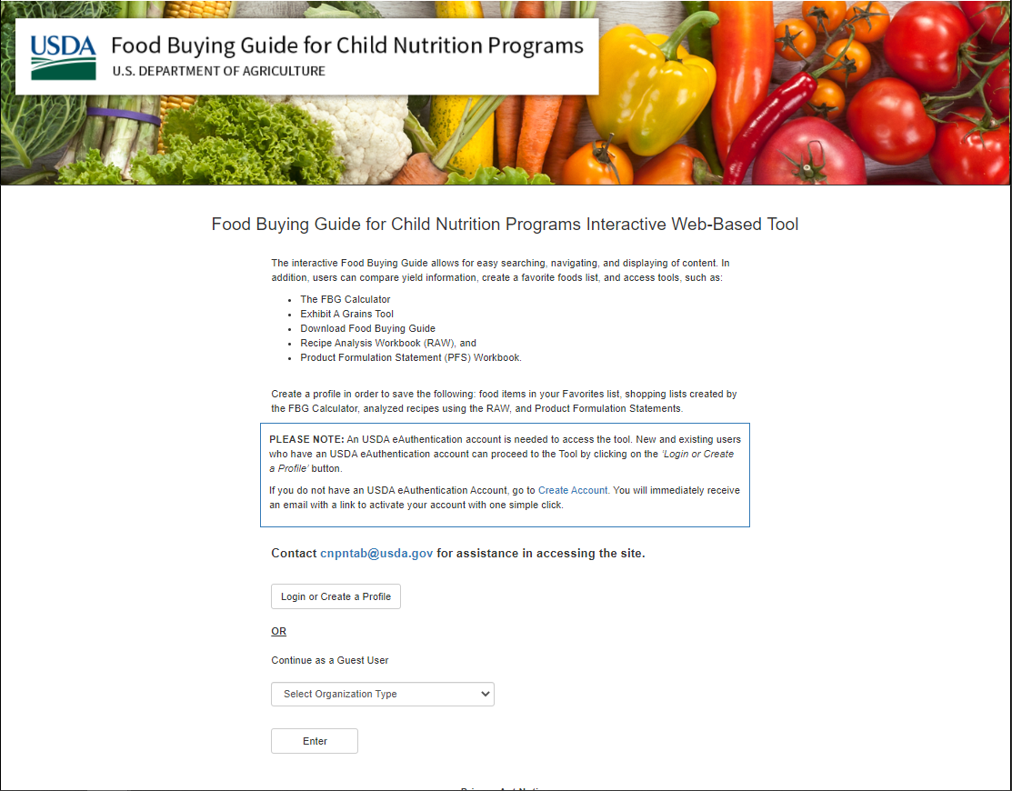
Exhibit A Grain Tool
USDA Food Buying Guide (FBG)
https://foodbuyingguide.fns.usda.gov/
Can create a profile to save entries, or enter as a guest

Slide 46
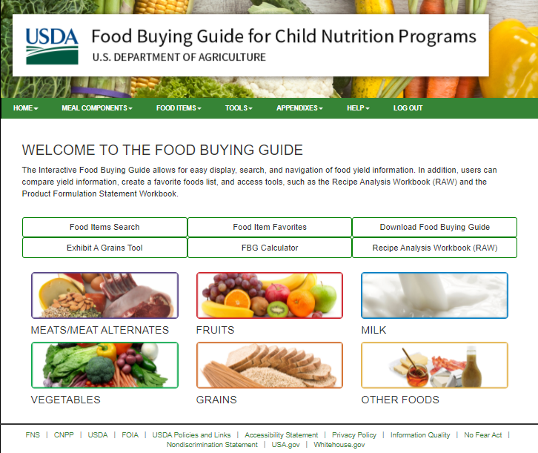
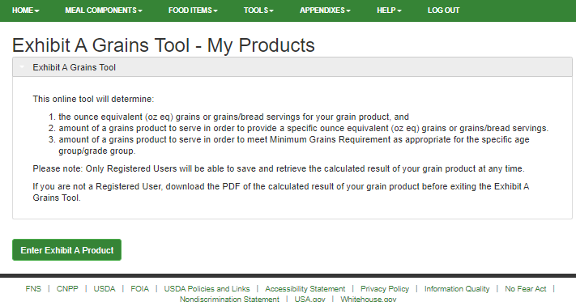
Exhibit A Grains Tool

Slide 47
Exhibit A Grains Tool
The tool has extensive instructions (including a step-by-step video) to explain how to enter in items, and use the tool to calculate the amount to serve
Note: this tool will provide you with fractions of servings to get to the minimum ounce equivalent (may be less than what you calculate using other method)

Slide 48
Questions
04

Slide 49
Certificate of training completion
Please use this link to access a brief survey and get your certificate of training completion:
https://survey.alchemer.com/s3/6727146/FY22-CACFP-Calculating-Ounce-Equivalents-Worksheet

Slide 50
CACFP Training Needs
We are still collecting input on what training topics our programs would like to see!
Please take 5 minutes to let me know what training topics of materials would be most beneficial:
https://survey.alchemer.com/s3/6601545/CACFP-FY22-Training-Needs-Assessment
Notes:
https://survey.alchemer.com/s3/6601545/CACFP-FY22-Training-Needs-Assessment

Slide 51




THANK YOU
Shannon Raymond, MPH
Training Coordinator
781.338.6471
Shannon.Raymond@mass.gov
www.doe.mass.edu
75 Pleasant Street, Malden, MA 02148
Notes:
SR: Thank you

