Slide 1
Welcome to Feeding Infants Using Ounce Equivalents Training
To access a recording of the presentation, please use the following link:
https://us02web.zoom.us/rec/share/M8zWzZgF73KT0O4oXft_uyzK6EV8ZiDYof1P2kNhRTV9orhdPYHVt8mkmmGKJnLE.2xiMAA3hjceFKAo2
Edits to the presentation (not captured in the recording) are highlighted in yellow.

Slide 2
USDA Notice: Infant Formula Recall (02/22/2022)
Important: Infant Formula Recall
Following FDA’s announcement of an advisory to alert consumers to avoid purchasing or using certain powdered infant formulas, Abbott announced a voluntary recall of powder formula including Similac, Alimentum, and EleCare manufactured in Sturgis, MI citing four consumer complaints related to Cronobacter sakazakii and Salmonella Newport in infants. Please share this information as appropriate.
Check website (linked here) for details on how to determine if a product is part of this recall

Slide 3
Feeding Infants Using Ounce Equivalents for Grains
FY22 CACFP Training

Slide 4
Current USDA nondiscrimination statement
In accordance with Federal civil rights law and U.S. Department of Agriculture (USDA) civil rights regulations and policies, the USDA, its Agencies, offices, and employees, and institutions participating in or administering USDA programs are prohibited from discriminating based on race, color, national origin, sex, disability, age, or reprisal or retaliation for prior civil rights activity in any program or activity conducted or funded by USDA.
Persons with disabilities who require alternative means of communication for program information (e.g. Braille, large print, audiotape, American Sign Language, etc.), should contact the Agency (State or local) where they applied for benefits. Individuals who are deaf, hard of hearing or have speech disabilities may contact USDA through the Federal Relay Service at (800) 877-8339. Additionally, program information may be made available in languages other than English.
To file a program complaint of discrimination, complete the USDA Program Discrimination Complaint Form, (AD-3027) found online at: How to File a Complaint, and at any USDA office, or write a letter addressed to USDA and provide in the letter all of the information requested in the form. To request a copy of the complaint form, call (866) 632-9992. Submit your completed form or letter to USDA by:
(1) mail: U.S. Department of Agriculture
Office of the Assistant Secretary for Civil Rights
1400 Independence Avenue, SW
Washington, D.C. 20250-9410;
(2) fax: (202) 690-7442; or
(3) email: program.intake@usda.gov.
This institution is an equal opportunity provider.
4

Slide 5
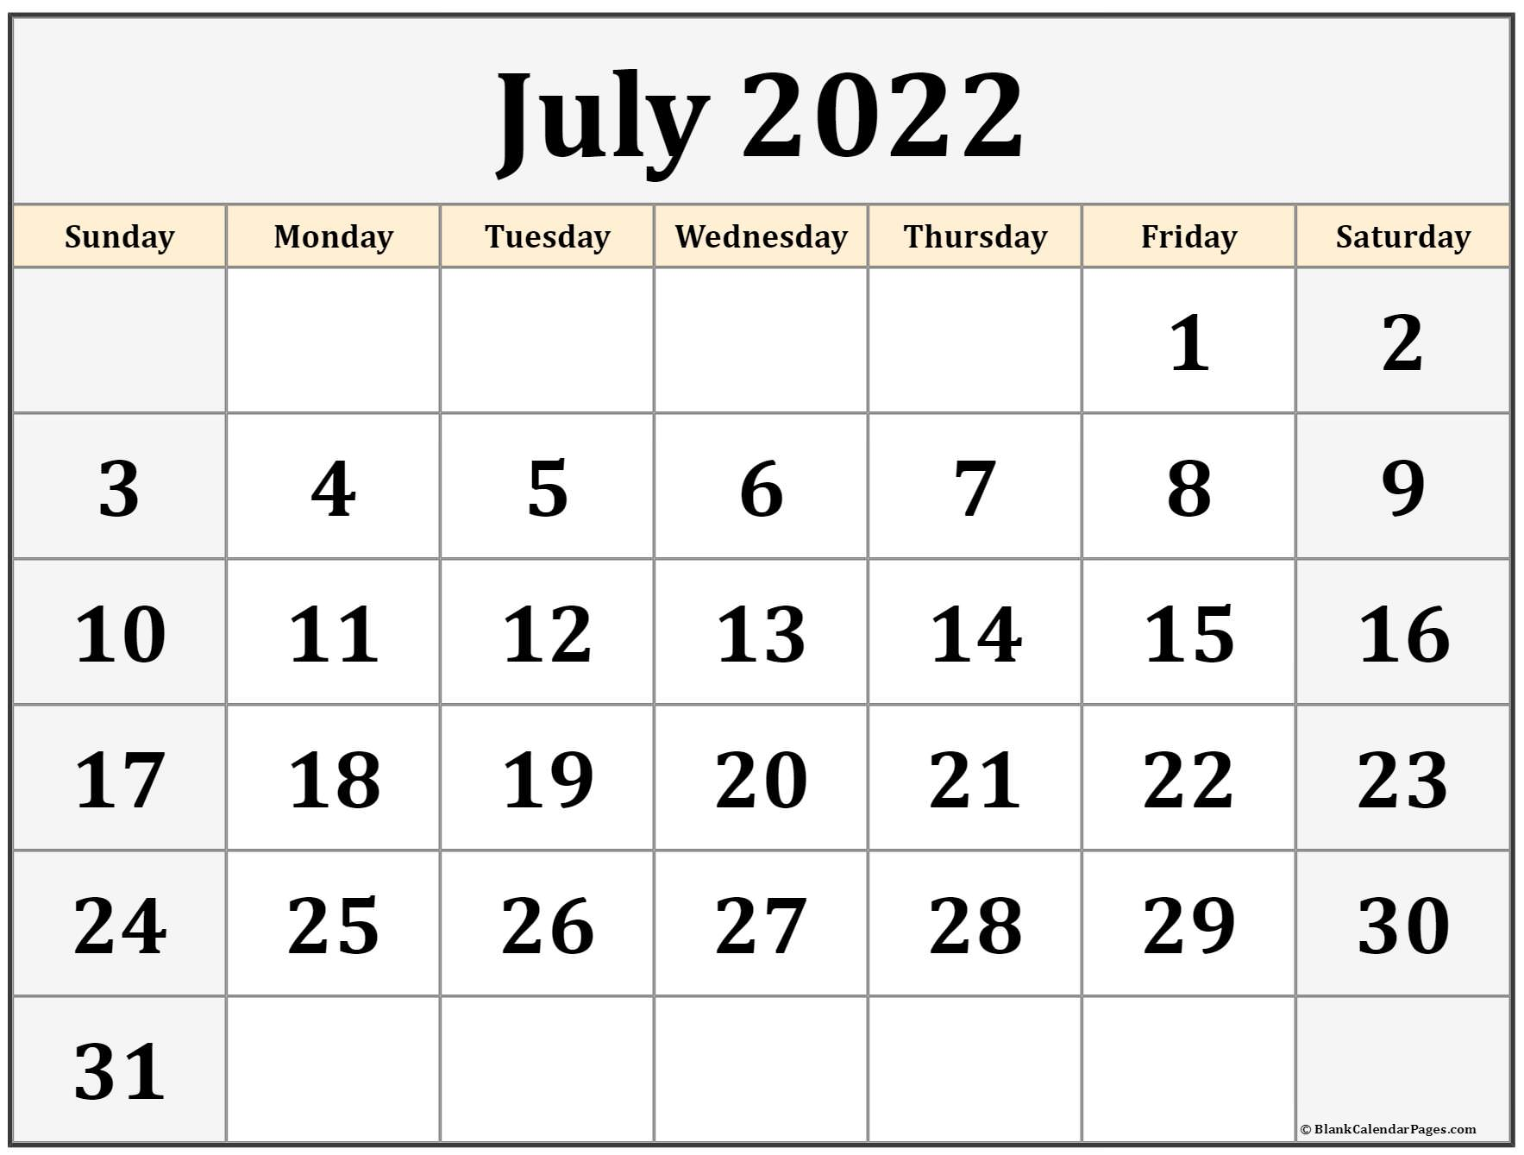
Ounce Equivalents Implementation
USDA has extended a waiver to delay the implementation of ounce equivalents for grains in the CACFP through June 30, 2022
Starting on July 1, 2022, CACFP programs are expected to begin utilizing ounce equivalents for grains
The Document and Reference Library has all previous oz eq trainings

Slide 6
Goal for today
Identify which infant grains will need to be calculated using ounce equivalents
Walk through the process for determining oz eq for infants worksheet
  How to use this form
  Examples

Slide 7
When do infant meals need to include ounce equivalents?
01

Slide 8
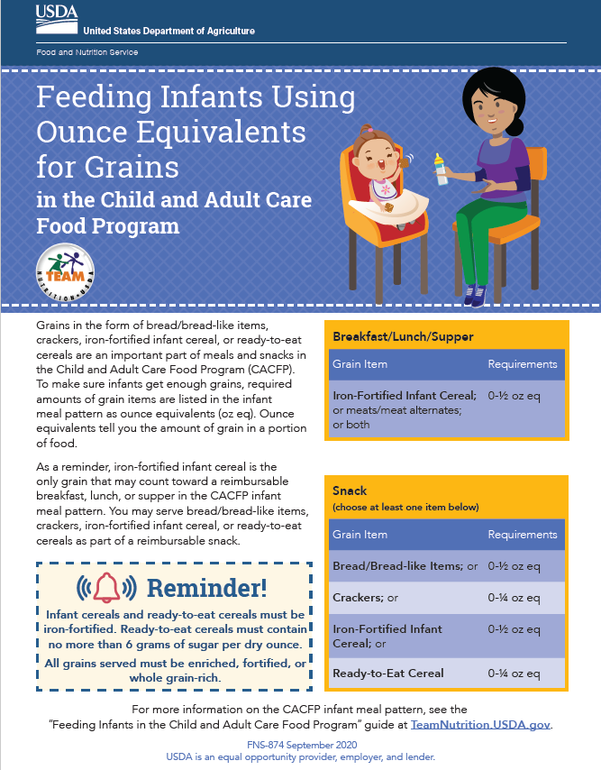
Feeding Infants Using Ounce Equivalents for Grains
Infant grains include bread/bread-like items, crackers, iron-fortified infant cereal, and ready-to-eat cereal
  Bread/bread-like items, crackers, and ready-to-eat cereal are only creditable as part of a snack
Minimum amounts of these grains are transitioning to ounce equivalents

Slide 9
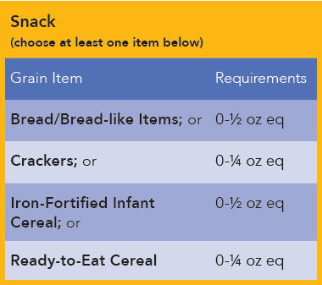
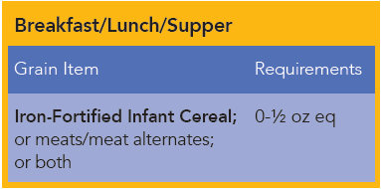
Ounce equivalents of grains for infants (6-11 months)

Slide 10
Feeding infants using oz eq for grains
You don’t need to document your method anywhere, but whoever is determining oz eq should be able to answer questions on their methods, if needed

Slide 11
Documenting oz eq for infants
Infant menus include serving sizes of items to identify developmental readiness for infants to consume specific components
DESE menu template’s will be updated to reflect the transition to ounce equivalents for grains (Spring 2022)
CACFP sites/providers should list the amount of grains offered to the infant in ounce equivalents

Slide 12
Using the Feeding Infants Using Ounce Equivalents Worksheet
02

Slide 13
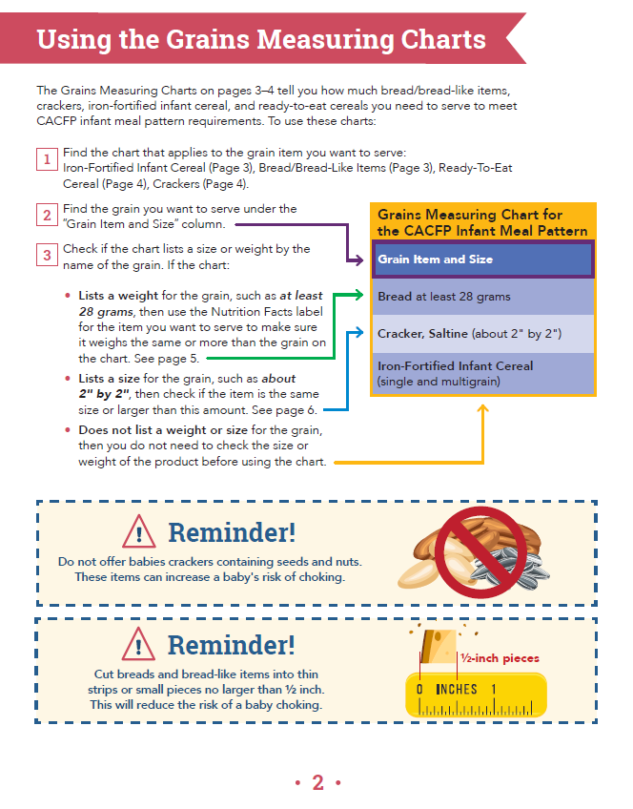
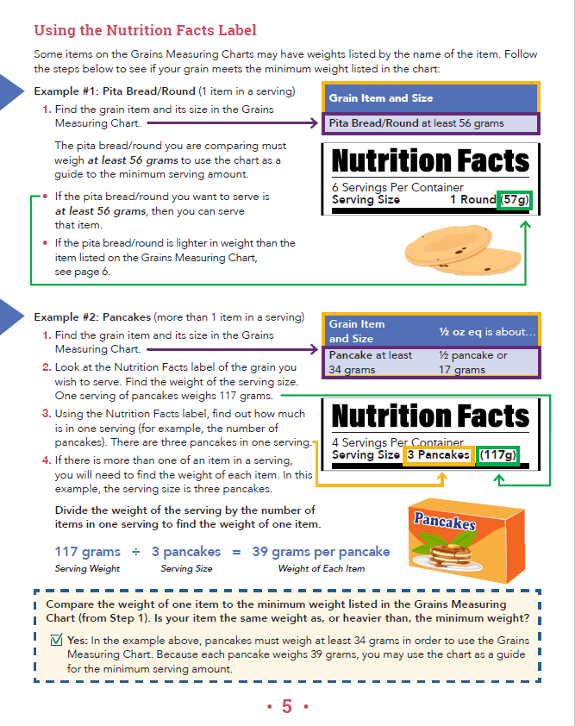
Feeding Infants Using Ounce Equivalents for Grains
See chat for a copy of this worksheet

Slide 14
Using the worksheet
This worksheet will be useful for grains commonly served to infants
The process is very similar to the Determining Ounce Equivalents process, outlined in the February 1, 2022, training (a recording of this training is available in the Online Document Library)

Slide 15
Using the ounce equivalents for infants worksheet
Step 2: Find the grain
Step 3: Grain by size
Use measuring tools to see if grain is at least the minimum listed size
Step 3: Grain by weight
Use nutrition facts label to see if grain is at least the minimum listed weight
Step 3: Grain without qualifier
Use chart for serving size
Use chart for serving size
Use chart for serving size
Step 1: Identify the correct chart

Slide 16
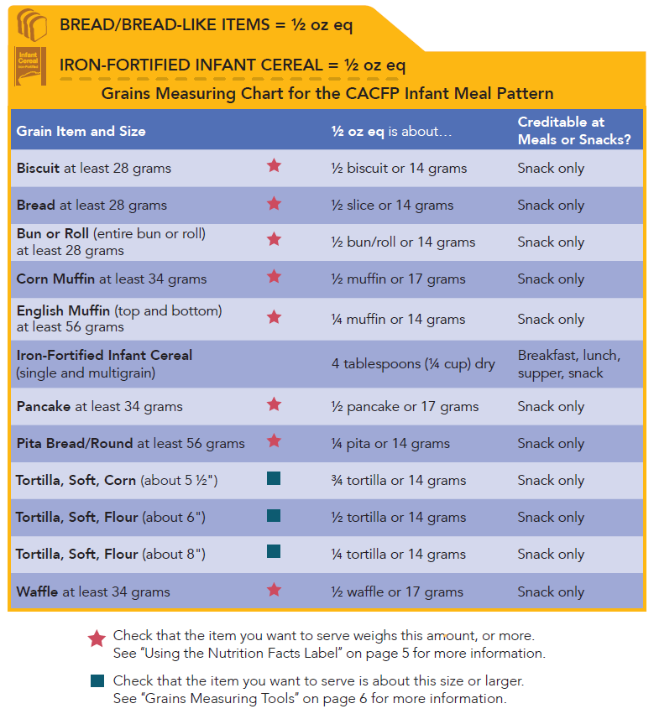
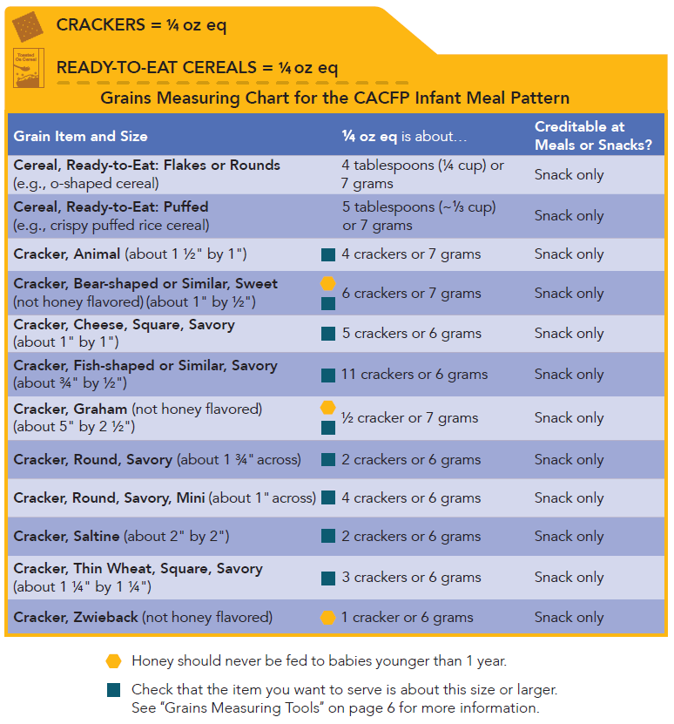
Step 1: Select the appropriate grain chart
Bread/Bread-Like Items, Iron Fortified Infant Cereal (1/2 oz eq)
Crackers, Ready-to-Eat Cereal (1/4 oz eq)

Slide 17
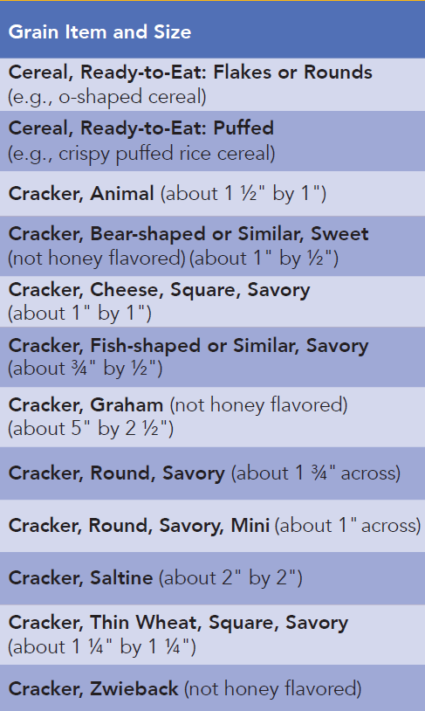
Step 2: Find the specific grain & how it is measured
Items listed on the chart will be qualified by either a minimum weight, size (dimensions), or nothing
Identify the grain item to be served
Identify if grain is measured by:
  Weight (grams)
  Size (dimensions)
  Neither

Slide 18
Step 3: Grain by Weight- Nutrition Facts Label
Find the serving size
  Weight of one serving, in grams
If the item at least the minimum weight (in grams) as is on the worksheet chart, then use the chart to figure out how much should be served

Slide 19
Step 3: Grain by Size- Dimensions of Item
Measure the grain item
If the item at least the minimum size (dimensions) as is on the worksheet chart, then use the chart to figure out how much should be served

Slide 20
Examples
03

Slide 21
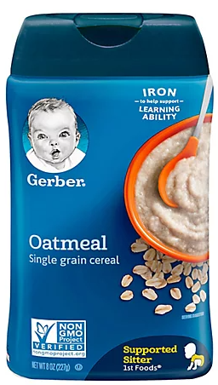
Example 1: Cereal
DESE’s Childcare Center is serving infant cereal as part breakfast for the infant room
Currently, they know to offer between 0-4tbl of cereal to meet the minimum serving size
How much will they need to serve using to meet the 0-½ oz eq requirement?

Slide 22
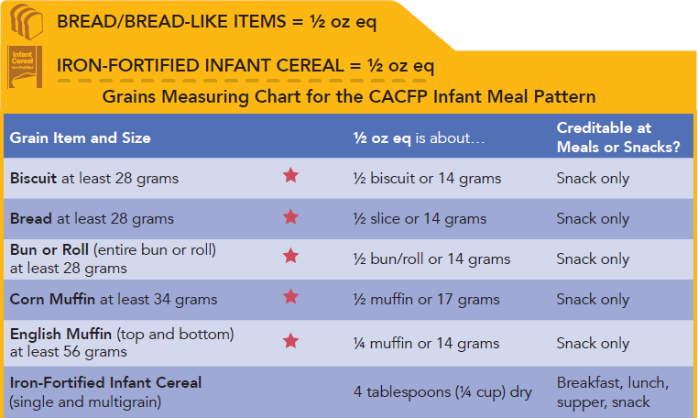
Step 1: Identify the correct list and the specific item
Which list would you use
What is the item?

Slide 23
Step 1: Identify the correct list and the specific item
Which list would you use
What is the item?

Slide 24
Step 2: How is the item qualified?
Look at the chart
Find the type of grain to be served
See if there are any qualifiers with this grain
  Weight or size

Slide 25
Step 2: How is the item qualified?
No weight or size minimum associated with this type of grain
What’s the next step?

Slide 26
Step 3: Go to the chart how much do I need?
Serving infant cereal at breakfast
½ oz eq is equal to 4 tablespoons, or ¼ cup of dry cereal

Slide 27

Example 2: Waffles
FNP’s family day care home is serving a waffle with snack to an infant
To meet the minimum serving size, they would give the infant around ½ a waffle (it’s an appropriate amount for this infant)
How much of a waffle will they need to offer to meet the minimum amount in ounce equivalents?

Slide 28
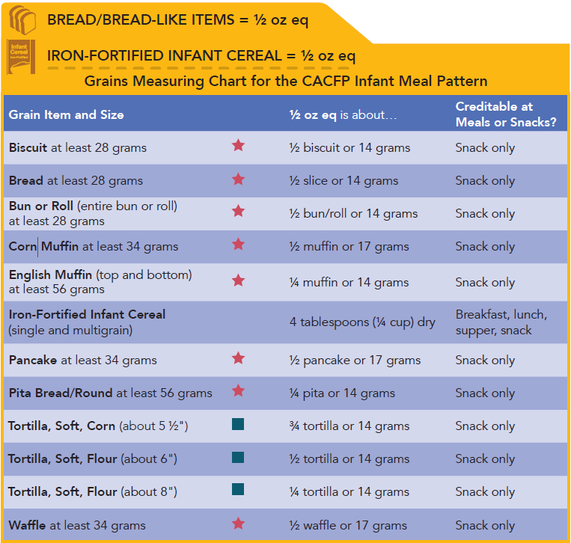
Step 1: Identify the correct list and the specific item
Which list would you use
What is the item?

Slide 29
Step 1: Identify the correct list and the specific item
Which list would you use
What is the item?

Slide 30
Step 2: How is the item qualified?
Look at the chart
Find the type of grain to be served
See if there are any qualifiers with this grain
  Weight or size

Slide 31
Step 2: How is the item qualified?
The waffle is qualified by weight
  Waffle must be at least 34 grams to use the chart to qualify it
What’s the next step?

Slide 32
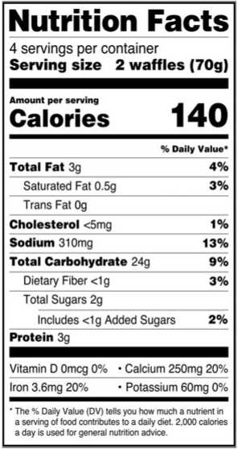
Step 3: Nutrition Facts Label
Identify the size (weight) of one serving
  70 grams
Identify how much is in one serving
  2 waffles
Determine the weight per item
  70 grams/2 waffles= 35 g/waffle
Does this meet the minimum weight identified in the chart?

Slide 33
Step 3: How much to serve?
Minimum weight for a waffle is 34 grams
  These waffles are greater than the minimum weight, so chart can be used
To offer ½ oz eq of waffles, it would be about ½ a waffle

Slide 34
What is the waffle did not meet the weight minimum?
Will need to use another method to understand the minimum amount
  “Calculating Ounce Equivalents” training
  Food Buying Guide Exhibit A Grains Tool
When shopping, use the chart to identify which item(s) meet the minimum weight and if possible, purchase those to avoid additional calculations

Slide 35
Example 3: Crackers
FDC home is offering Ritz crackers with snack to a 10-month-old infant who is developmentally ready
This infant would normally receive 2 crackers at snack
How many crackers are needed to provide ½ oz eq?
  STEP 1: Find the item on the chart
  STEP 2: See if the item is qualified by weight or size, and that it meet the minimum size/weight requirements
  STEP 3: Use the chart to determine how much of the item should be served

Slide 36
Step 1: Identify the correct list and the specific item
Which list would you use
What is the item?

Slide 37
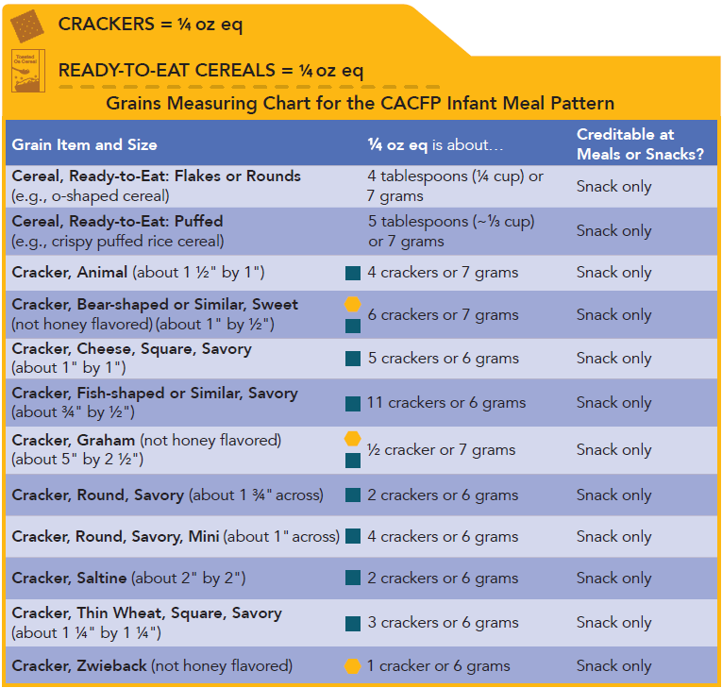
Step 1: Identify the correct list and the specific item
Which list would you use
  Crackers, Ready-to-Eat Cereals
What is the item?
  Cracker, Round, Savory

Slide 38

Steps 2: Find the grain item and how it’s quantified
Step 1: Find round crackers on the grains chart
Step 2: Identify how graham crackers are measured
  SIZE: “about 1 ¾” across”

Slide 39
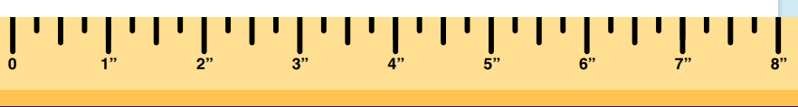
Grains measuring tool
The worksheet, when printed on 8 ½” by 11” paper at 100% provides an accurate guide for measuring grains
  Cracker is just under 2” across, larger than the 1 ¾” requirement

Slide 40
Step 3: Go to the chart, how much grain do I need?
Go to the chart and see how much of the grain should be served

Slide 41
Step 3: Go to the chart, how much grain do I need?
2 crackers

Slide 42
Additional resources forthcoming
To support centers and FDC sponsors in the implementation of ounce equivalents for grains, DESE will be creating some additional resources
  Shopping lists of common grains with ounce equivalents calculated
  Common recipes with ounce equivalents
If there’s any specific resource that will benefit your staff/providers? Email Shannon (Shannon.Raymond@mass.gov)

Slide 43
Questions
04

Slide 44
Certificate of training completion
Please use this link to access a brief survey and get your certificate of training completion: https://survey.alchemer.com/s3/6744265/FY22-CACFP-Ounce-Equivalents-for-Infants
Notes:
https://survey.alchemer.com/s3/6744265/FY22-CACFP-Ounce-Equivalents-for-Infants

Slide 45
CACFP Training Needs
We are still collecting input on what training topics our programs would like to see!
Please take 5 minutes to let me know what training topics of materials would be most beneficial:
https://survey.alchemer.com/s3/6601545/CACFP-FY22-Training-Needs-Assessment
Notes:
https://survey.alchemer.com/s3/6601545/CACFP-FY22-Training-Needs-Assessment

Slide 46
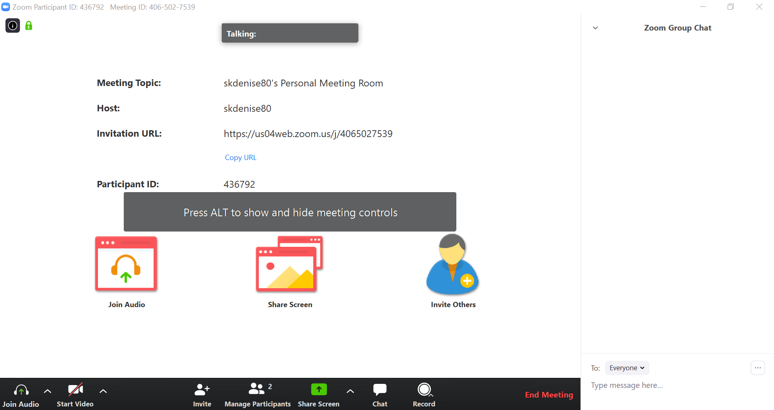
Questions?
Enter your question here
To ask a question open the chat box

Slide 47




THANK YOU
Shannon Raymond, MPH
Training Coordinator
781.338.6471
Shannon.Raymond@mass.gov
www.doe.mass.edu
75 Pleasant Street, Malden, MA 02148
Notes:
SR: Thank you

