Slide 1
Link to training recording
To access a link to the recording of the November 9th training, use this link: https://us02web.zoom.us/rec/share/8ICYd5_go57UXNe4nsOGKAtvQkB6r0wbYIrmJ38I16ZrvmevZexEffhXEK_x9N_A.8gYGUjQeRO7g566V
A link to the training certificate can be found at the end of this presentation

Slide 2
Transitioning to Ounce Equivalents for Grains in the CACFP
FY22 CACFP Training

Slide 3
Current USDA nondiscrimination statement
In accordance with Federal civil rights law and U.S. Department of Agriculture (USDA) civil rights regulations and policies, the USDA, its Agencies, offices, and employees, and institutions participating in or administering USDA programs are prohibited from discriminating based on race, color, national origin, sex, disability, age, or reprisal or retaliation for prior civil rights activity in any program or activity conducted or funded by USDA.
Persons with disabilities who require alternative means of communication for program information (e.g. Braille, large print, audiotape, American Sign Language, etc.), should contact the Agency (State or local) where they applied for benefits. Individuals who are deaf, hard of hearing or have speech disabilities may contact USDA through the Federal Relay Service at (800) 877-8339. Additionally, program information may be made available in languages other than English.
To file a program complaint of discrimination, complete the USDA Program Discrimination Complaint Form, (AD-3027) found online at: How to File a Complaint, and at any USDA office, or write a letter addressed to USDA and provide in the letter all of the information requested in the form. To request a copy of the complaint form, call (866) 632-9992. Submit your completed form or letter to USDA by:
(1) mail: U.S. Department of Agriculture
Office of the Assistant Secretary for Civil Rights
1400 Independence Avenue, SW
Washington, D.C. 20250-9410;
(2) fax: (202) 690-7442; or
(3) email: program.intake@usda.gov.
This institution is an equal opportunity provider.
3

Slide 4
Goal for today
The goal for today’s presentation is to introduce the concept of ounce equivalents, and introduce some USDA tools and worksheets
DESE will continue to offer more trainings on this topic as we approach the July 1st implementation date
You won’t be expected to be an ounce equivalents expert at the end of this hour– more training and support is coming!

Slide 5
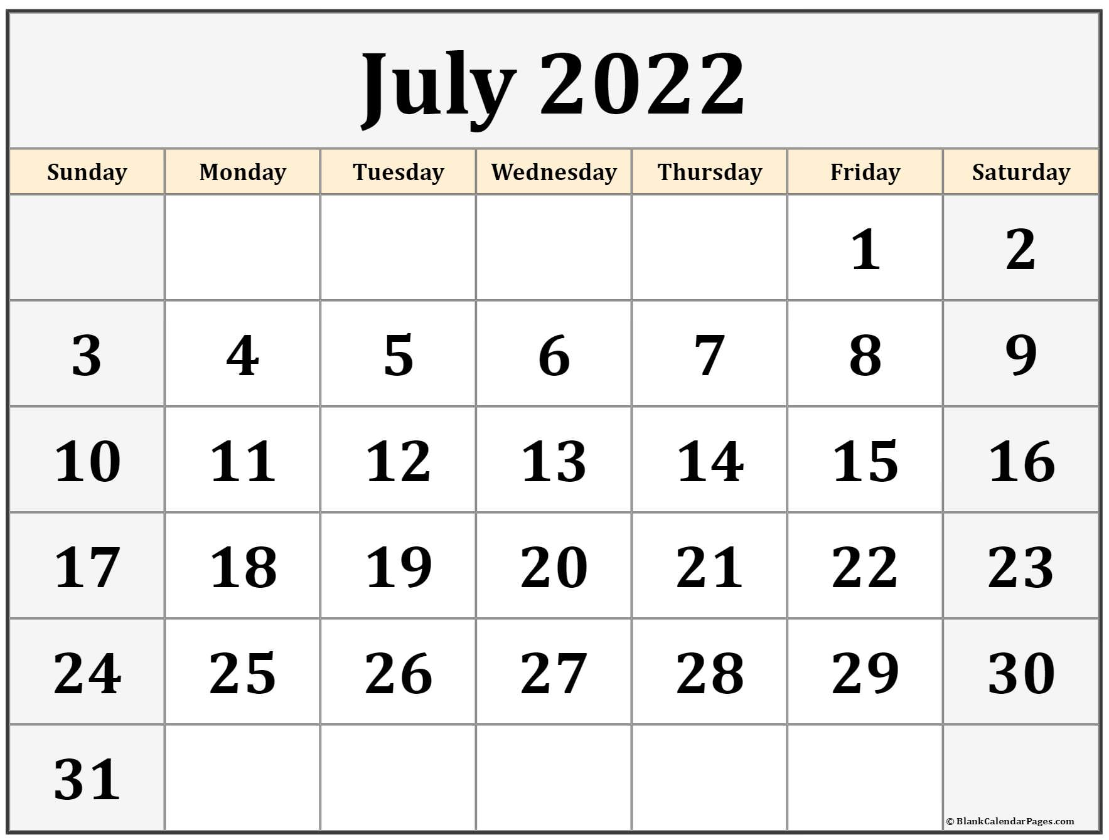
Ounce Equivalents Implementation
USDA has extended a waiver to delay the implementation of ounce equivalents for grains in the CACFP through June 30, 2022
Starting on July 1, 2022, CACFP programs are expected to begin utilizing ounce equivalents for grains

Slide 6
Agenda
What are ounce equivalents?
Using USDA resources
What if my grain is different?
Questions

Slide 7
What are Ounce Equivalents?
01

Slide 8
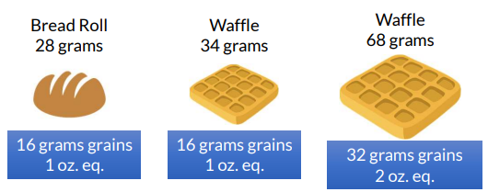
What are ounce equivalents?
A method of measuring grains in the CACFP
  Ounce equivalent= the amount of food you need to make up 16 grams of grain
The amount of grain in a product can vary based on the type of the item, and the size

Slide 9
Why the switch to ounce equivalents?
Ounce equivalents (oz eq) helps streamline the CACFP with other Child Nutrition Programs (CNP)
Oz eq are used by the National Dietary Guidelines for Americans, and with MyPlate consumer messaging
Oz eq helps programs to know they are serving the correct portions of grains to meet the nutritional needs of participants

Slide 10
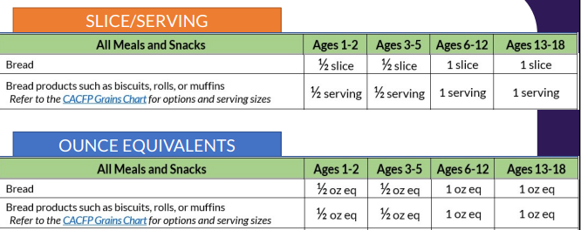
Oz eq vs. servings (children)
Direct transition from servings/slices to oz eq

Slide 11
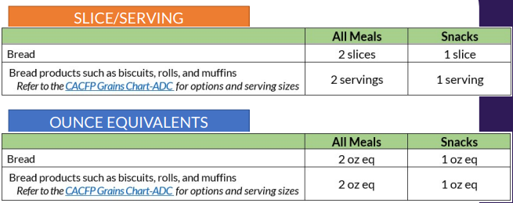
Oz eq vs. servings (adults)
Direct transition from servings/slices to oz eq

Slide 12
Using USDA resources
02

Slide 13
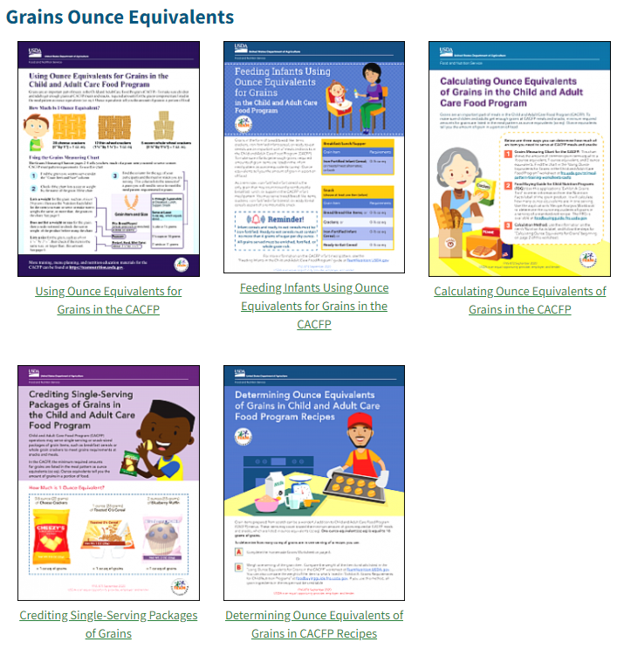
USDA handouts
USDA’s Team Nutrition page has a series of resources on Ounce Equivalents for grains
  Using Ounce Equivalents
  Feeding Infants using Ounce Equivalents
  Calculating Ounce Equivalents
  Crediting Single Serving Packages of Grains
  Determining Ounce Equivalents in Recipes

Slide 14
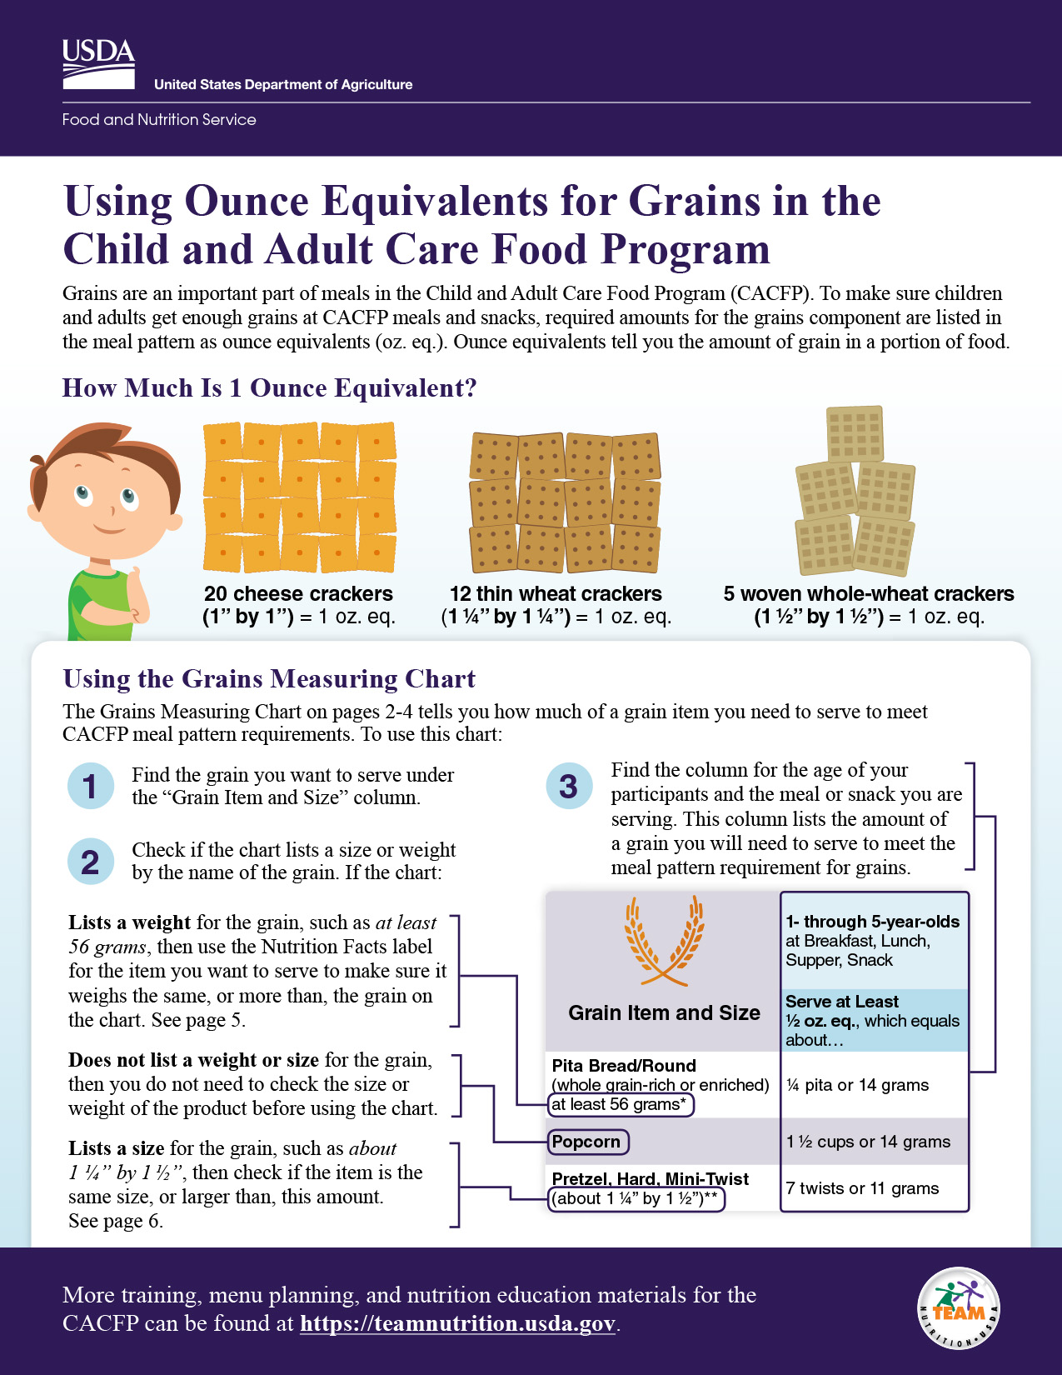
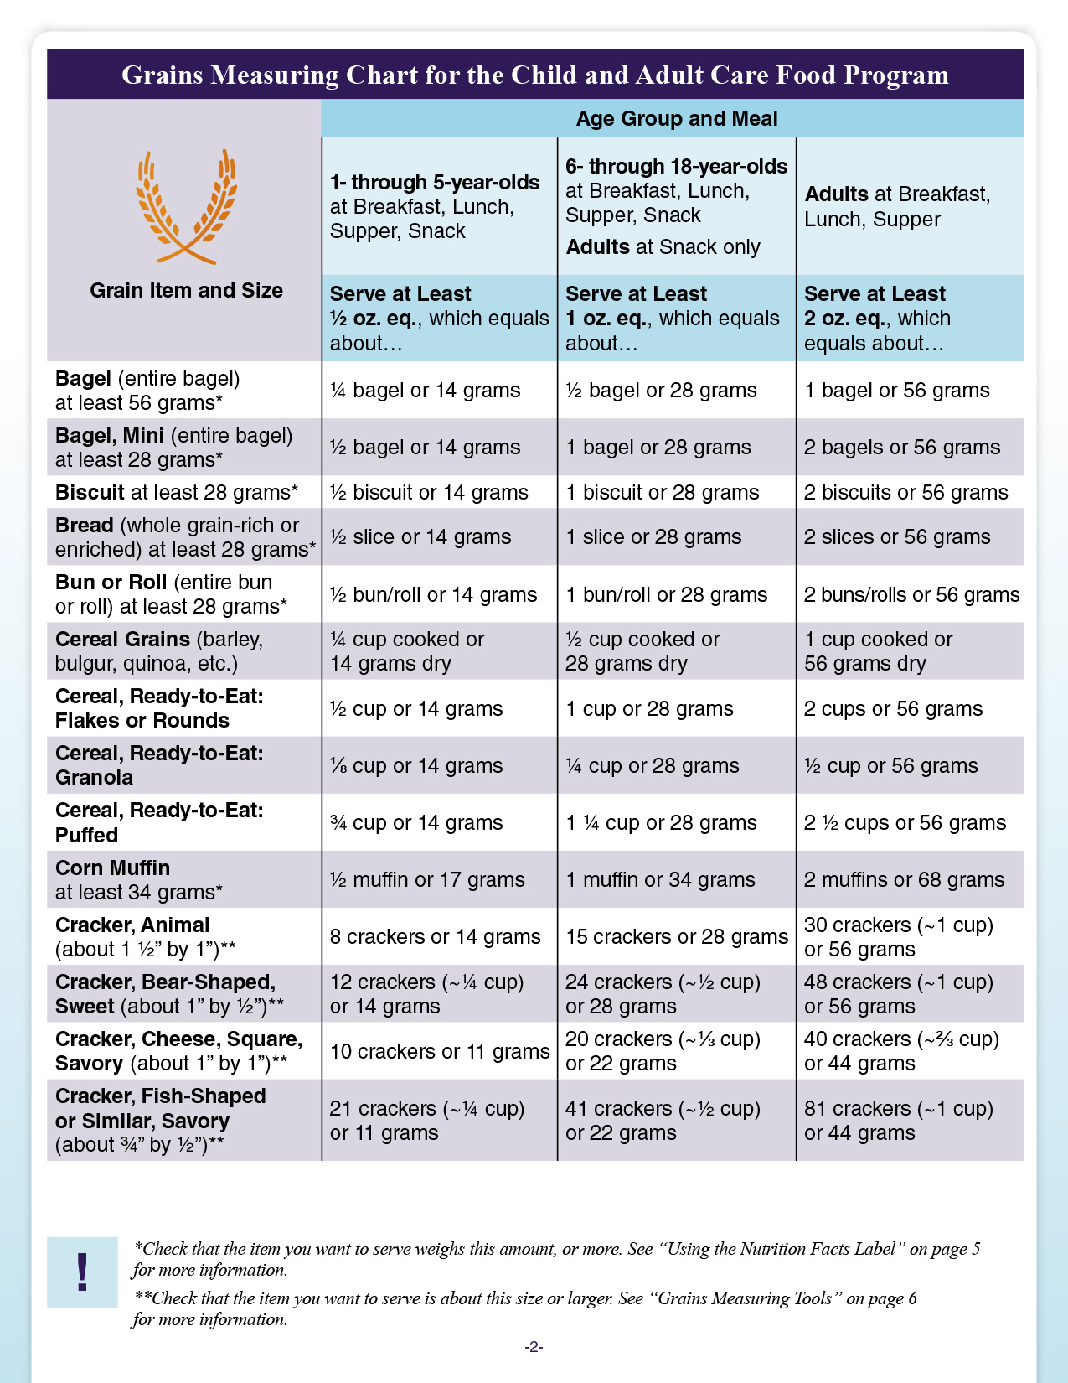
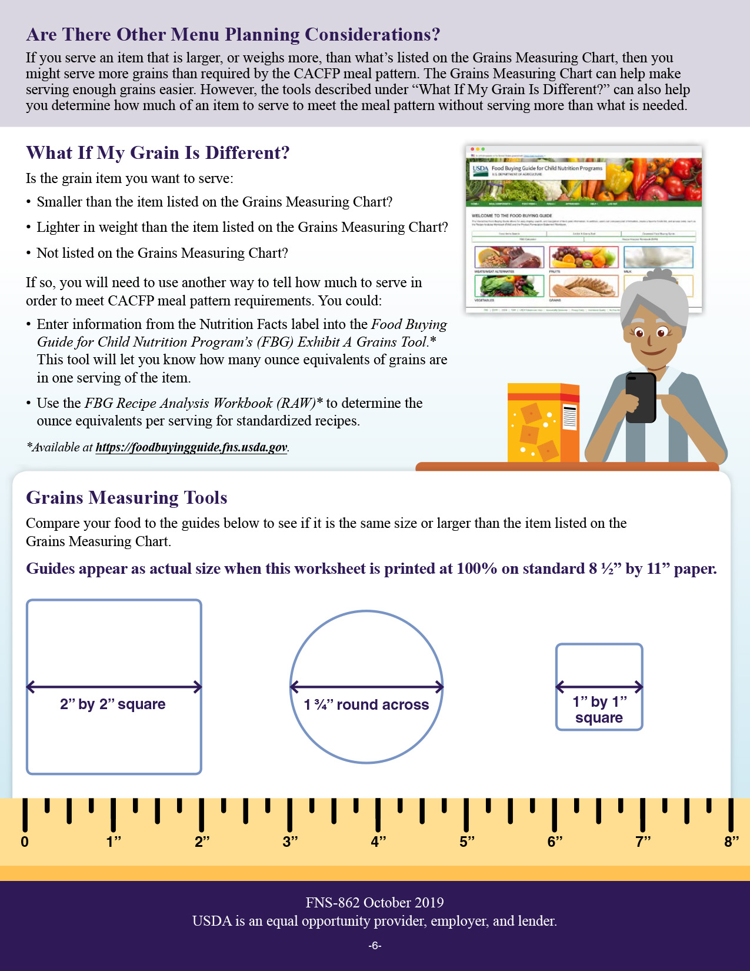
Using Ounce Equivalents in the CACFP Worksheet
See chat for a copy of this worksheet on understanding how to use oz eq in the CACFP

Slide 15
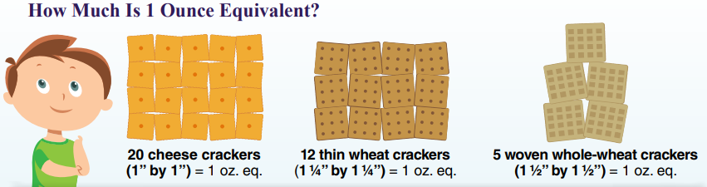
How much is 1 ounce equivalent?
Grain items come in all types, shapes, and sizes
USDA’s Grains Measuring Chart helps to detail how much of a grain item is needed to meet the meal pattern requirements

Slide 16
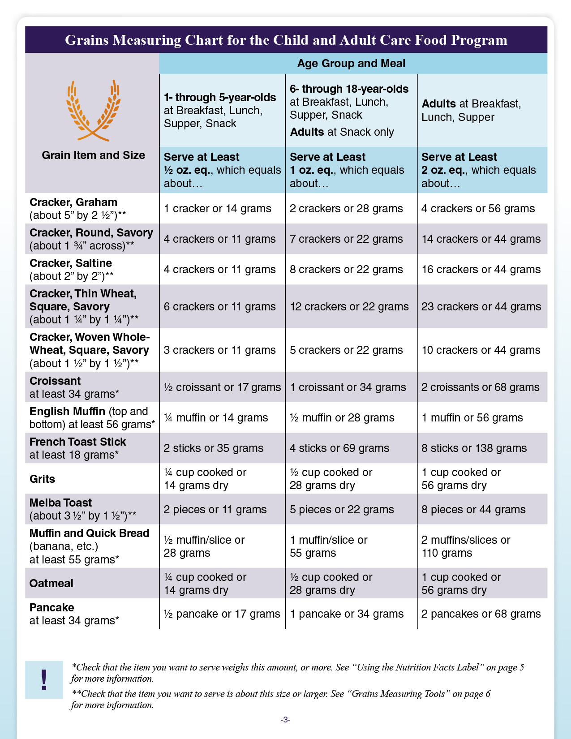
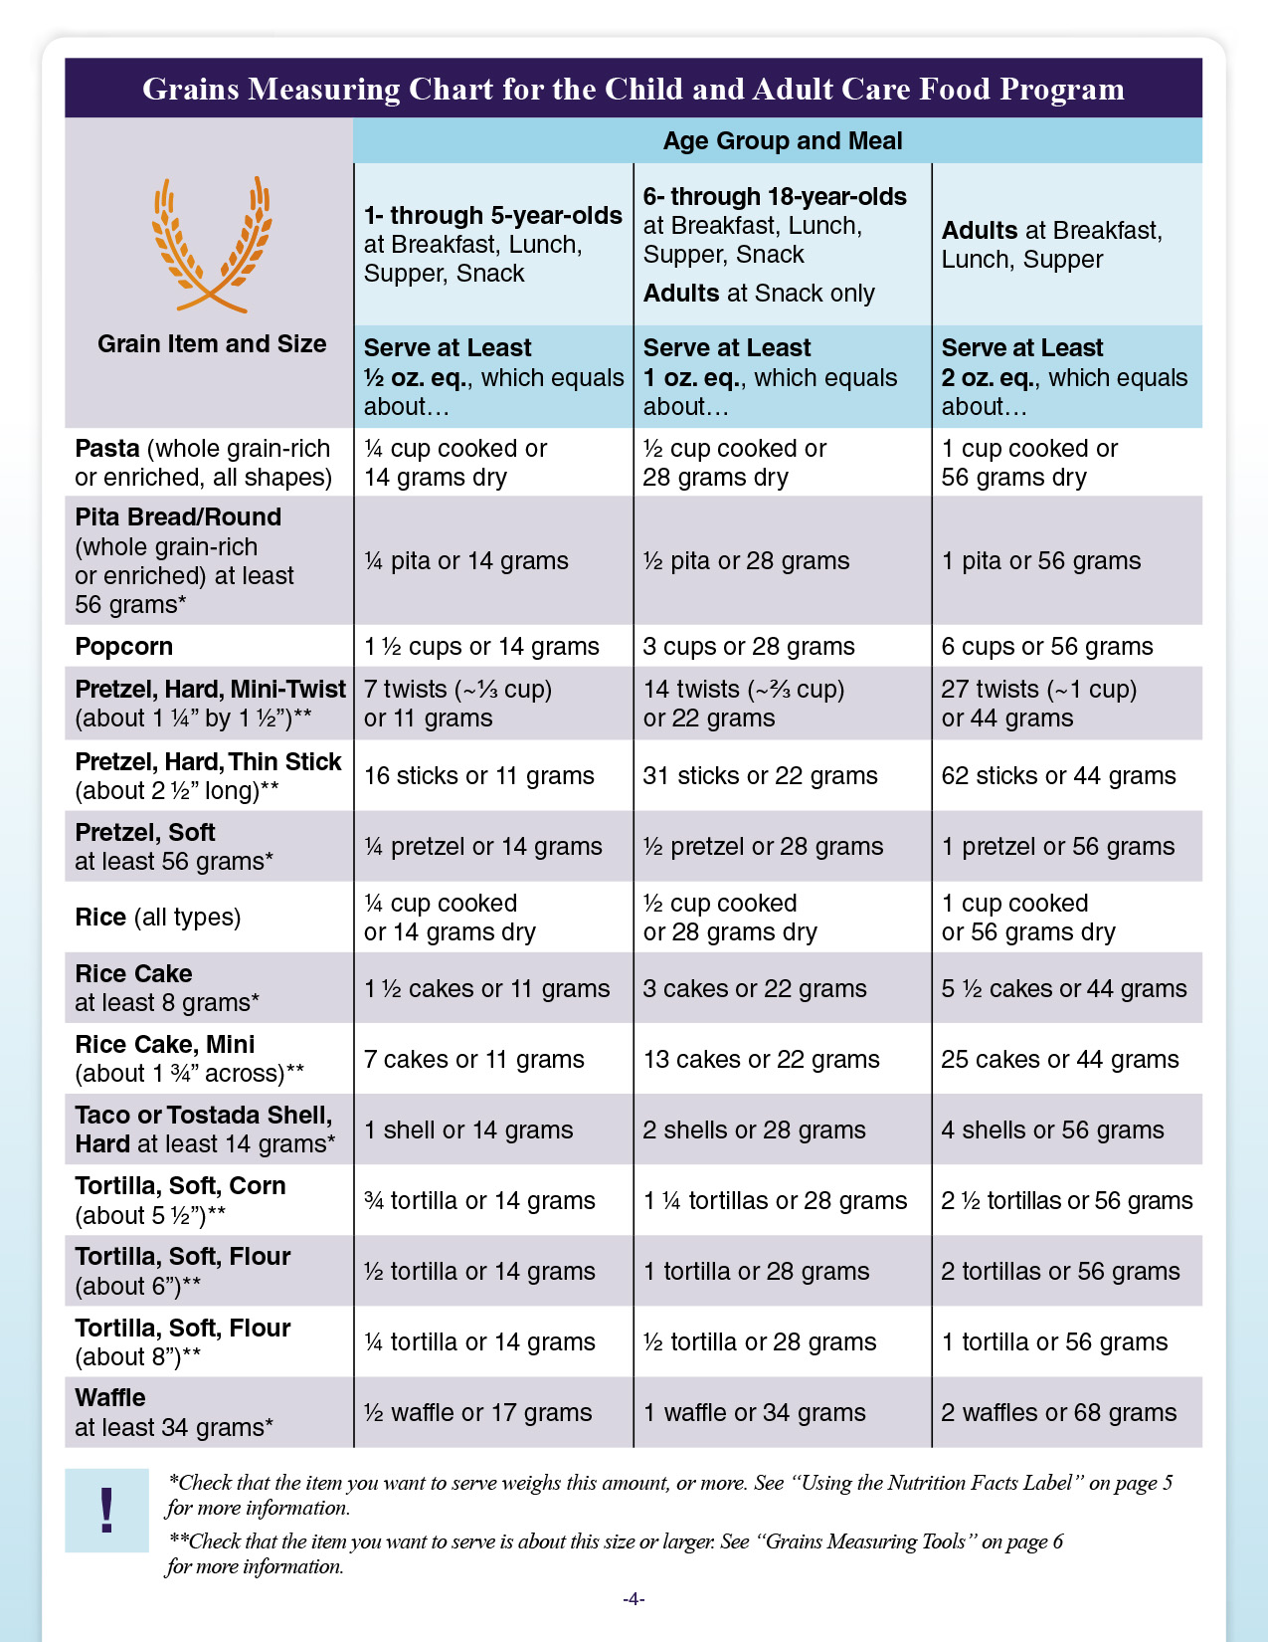
Grains Measuring Chart

Slide 17
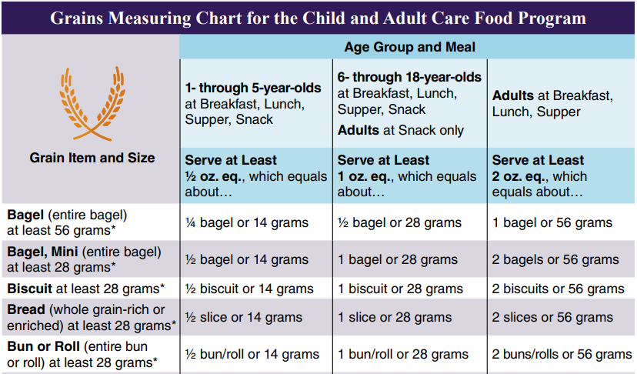
Using the Grains Measuring Chart
STEP 1: Find your Grain
You’ll find the names of grain items in the first column

Slide 18
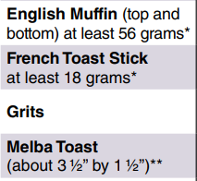
Using the Grains Measuring Chart
STEP 2: Identify how grain is quantified
See if there is a size or a weight by the name of the grain item
Weight: use Nutrition Facts label for the item to make sure it weighs at least the same amount as the grain on the chart
Neither: move on to next step
Size: check if item is the same size, or larger than this

Slide 19
Using the Grains Measuring Chart
STEP 3: Find your participant age group
The second column shows how much of the item is needed to make up ½ oz eq, which is the minimum amount needed for 1-5 year olds

Slide 20
Using the Grains Measuring Chart
The third column shows how much of the item is needed to make up 1 oz eq, which is the minimum amount needed for 6 -18 year olds (all meals and snacks), and for adults at snack

Slide 21
Using the Grains Measuring Chart
The fourth column shows how much of the item is needed to make up 2 oz eq, which is the minimum amount needed for adults at all meals

Slide 22
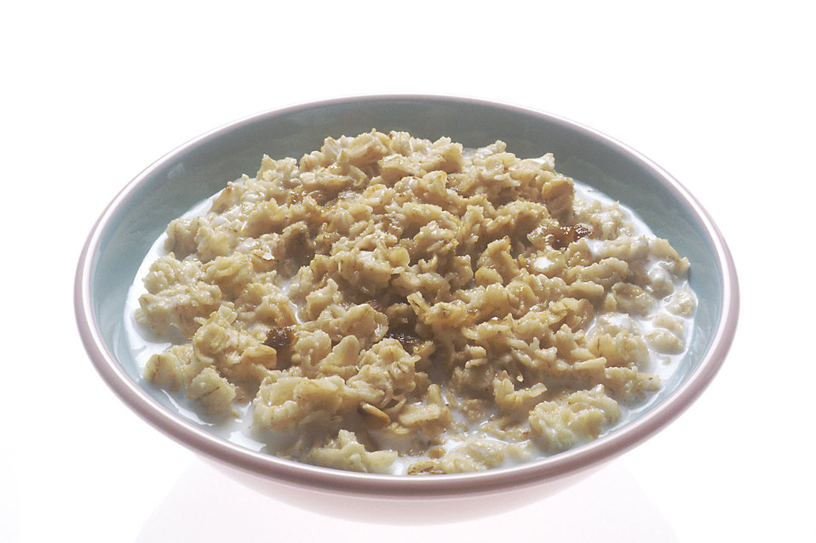
Example 1
You want to serve oatmeal for breakfast in the 5-year-old classroom at your childcare center. How much oatmeal is required to meet the minimum amount of grains?

Slide 23
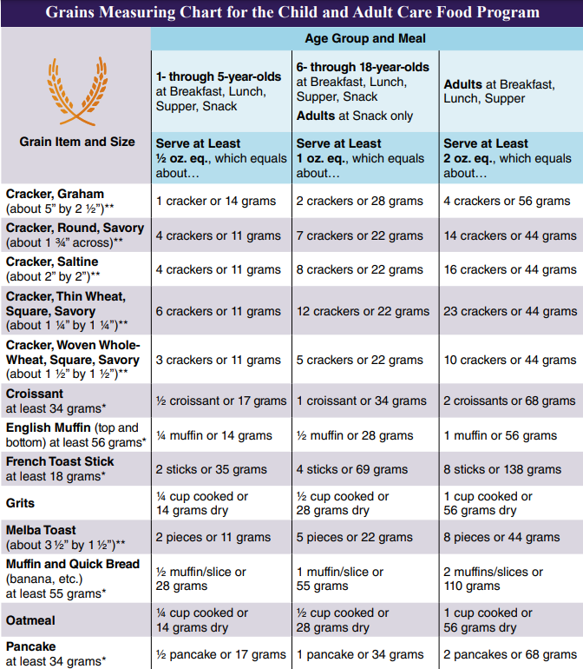

Step 1: Find the grain item on worksheet

Slide 24
Step 2: See how item is quantified
Oatmeal does not have any weight or size next to it, so it is not needed to check the size or weight of the oatmeal

Slide 25
Step 3: Find the age group
The second column is for children aged 1-5
The program should serve ¼ cup cooked oatmeal to meet the ½ oz eq grain requirement for this age group

Slide 26
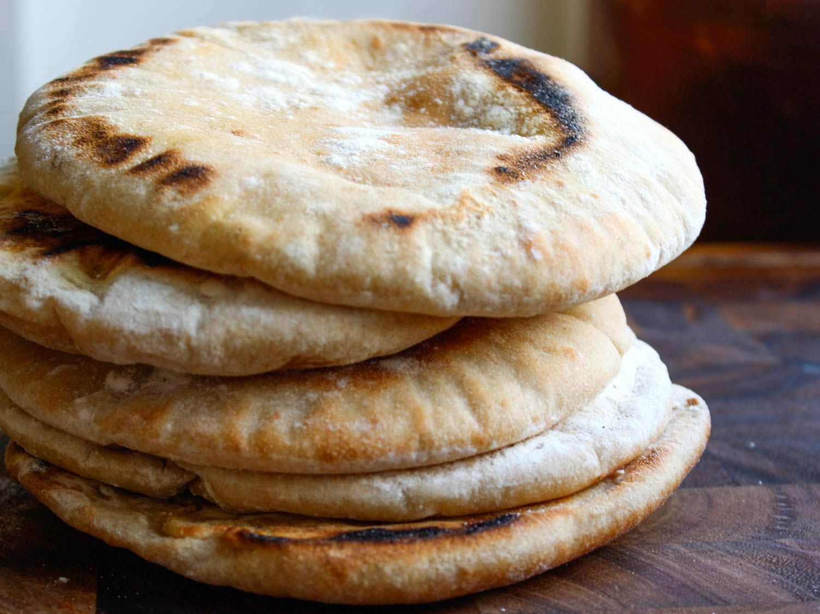
Example 2: Grains with weight
An Adult Day Health program wants to serve pita bread to go with your hummus and grilled chicken at lunch

Slide 27
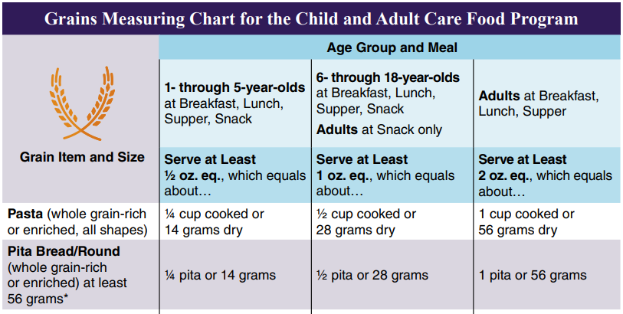
Steps 1 and 2: Find the grain item and how it’s quantified
Step 1: Find Pita bread/round on the grains chart
Step 2: Identify how Pita is measured
  “at least 56 grams”
    WEIGHT

Slide 28

Grains by weight
A minimum weight of grain is provided
Requires the use of the Nutrition Facts label to make sure that the item weighs at least this amount listed on grain chart

Slide 29
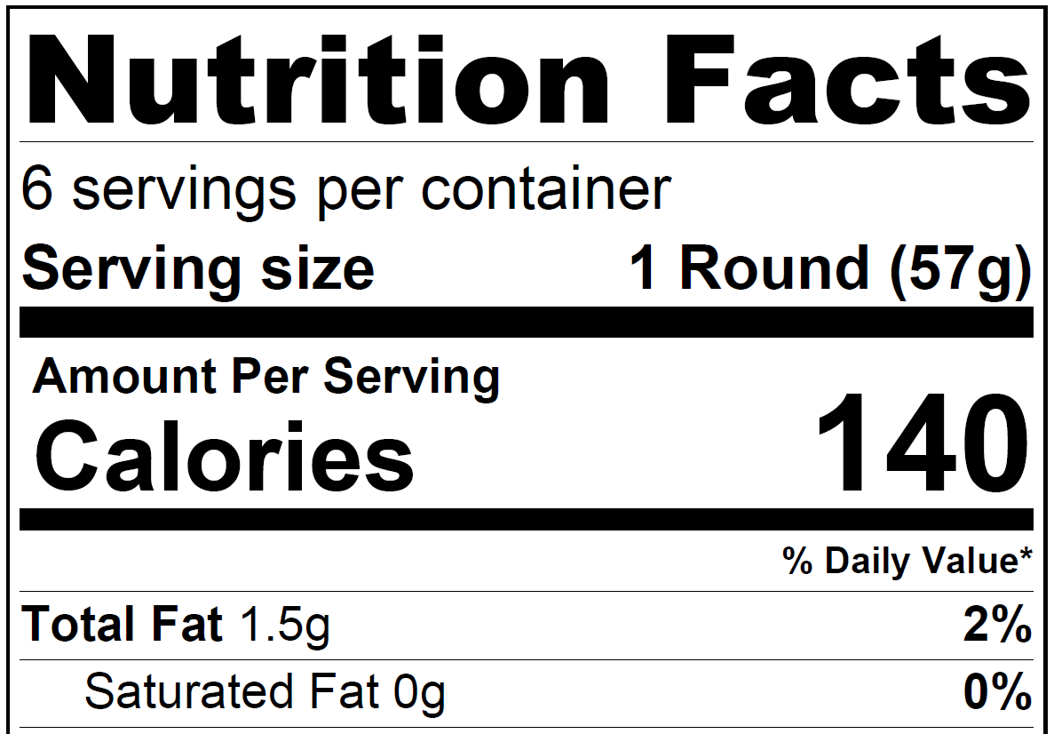

Nutrition Facts label
Find the serving size of the item on the Nutrition Facts label
Compare the serving size (in grams) to the minimum amount required in the worksheet
  Serving size= 57g
  Min. amount= 56g

Slide 30
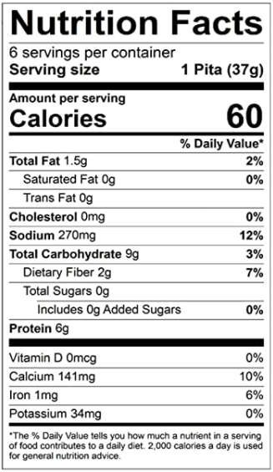
What happens if a serving size isn’t sufficient?
If a serving size does not meet minimum amount indicated in grains chart, then use a different method to determine how much to serve
Worksheet has “What If My Grain Is Different?” on page 6 of handout

Slide 31
Grain meets minimum amount in worksheet
If the grain meets the minimum amount of weight needed in the grains chart, the program can use the chart to learn how many pita rounds are needed to meet the meal pattern requirements

Slide 32
How much grain do I need?
Looking at the grains chart, find the column that corresponds to participant age group
  Adults= Column 4

Slide 33
How much grain do I need?
Find the amount of grain needed for serving adults at lunch
  1 pita

Slide 34
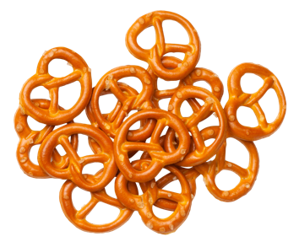
Example 3: Grains with size
An At-Risk program wants to serve hard pretzels as part of their afterschool snack

Slide 35
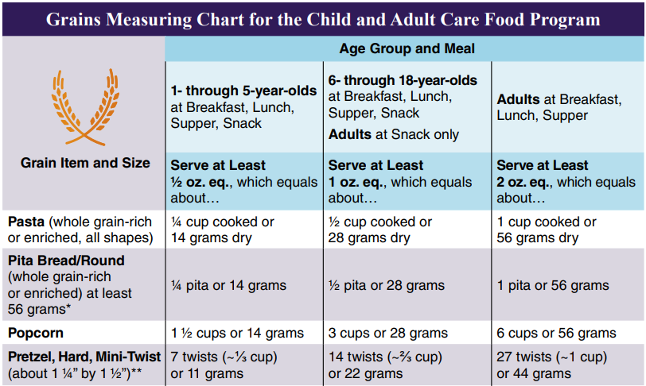
Steps 1 and 2: Find the grain item and how it’s quantified
Step 1: Find pretzels on the grains chart
Step 2: Identify how pretzels are measured
  (about 1 ¼” by 1 ½”)
    SIZE

Slide 36

Grains by weight
A minimum size of grain is provided
Requires the use of the Nutrition Facts label to make sure that the item is at least this size listed on grain chart

Slide 37
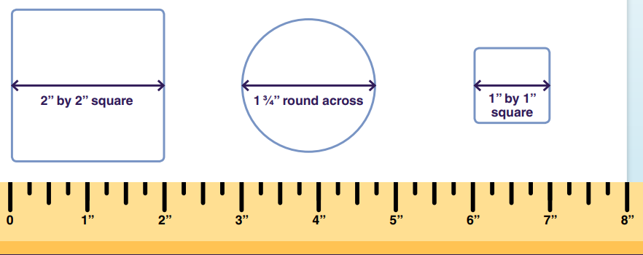
Grains measuring tool
The worksheet, when printed on 8 ½” by 11” paper at 100% provides an accurate guide for measuring grains
Common shapes of crackers or grains are included with a ruler

Slide 38

Grains measuring tool
No pretzel shaped template, so would use ruler to estimate size of item
  Pretzel is about 1 ½” across

Slide 39
Grains measuring tool
No pretzel shaped template, so would use ruler to estimate size of item
  Pretzel is about 1 ¼” tall

Slide 40
Comparing size of item to grains chart
Pretzel is about 1 ½” wide and 1 ¼” tall
Grains chart requires pretzel to be 1 ¼” by 1 ½”
Pretzel meets minimum size requirement to use chart
1 ¼”
1 ½”

Slide 41
What happens if a serving size isn’t sufficient?
If a size does not meet minimum amount indicated in grains chart, then should use a different method to determine how much to serve
Worksheet has “What If My Grain Is Different?” on page 6 of handout
1”
1”

Slide 42
Grain meets minimum amount in worksheet
If the grain meets the minimum size needed in the grains chart, the program can use the chart to learn how many pretzels are needed to meet the meal pattern requirements
1 ¼”
1 ½”

Slide 43
How much grain do I need?
Looking at the grains chart, find the column that corresponds to participant age group
  Children 6-18= Column 3

Slide 44
How much grain do I need?
Find the amount of grain needed for serving kids 6+ at snack
  14 pretzels (about 2/3 cup)

Slide 45
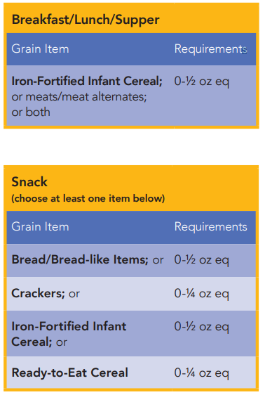
Serving infants using ounce equivalents for grains
Grains served to infants should also be measured using ounce equivalents
Infant meal pattern reminder:
  Iron-fortified infant cereal (IFIC) is the only grain reimbursable at breakfast, lunch, or supper
  Bread/like-items, crackers, IFIC, ready-to-eat cereals can be reimbursed at snack only
Oz Eq for infants’ worksheet in the chat

Slide 46
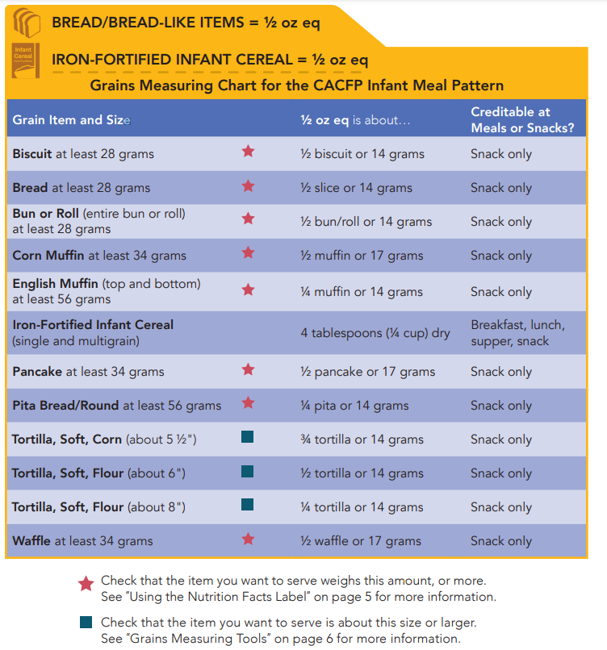
Serving infants using ounce equivalents for grains
Process for identifying oz eq for grains served to infants is the same as with children/adults
Use grain chart from handout for help identifying commonly served grains

Slide 47
Crediting single-serve containers of grains
Single-serve packages may or may not provide the minimum amount of grains required for a meal service
USDA created a resource, Crediting Single-Serving Packages of Grains in the Child and Adult Care Food Program
Programs should check that the single-serve package that you want to serve weighs enough to credit towards ounce equivalents

Slide 48
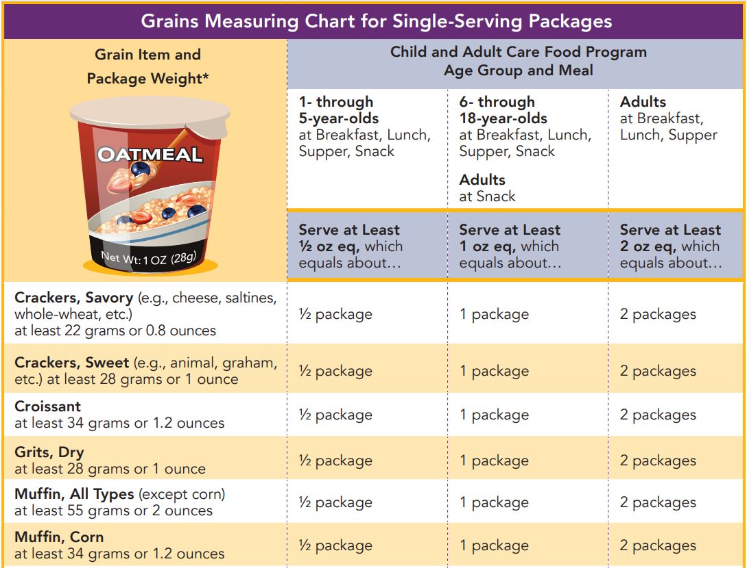
Grains chart: single serve packages

Slide 49
What if my grain is different?
03

Slide 50
What if my grain is different?
What if the grain you want to use is:
  Not on the worksheet’s Grains Chart?
  Lighter than the minimum weight in the grains chart?
  Smaller than the minimum size in the grains chart?
You’ll need to use another method to understand how much to serve to meet the meal pattern requirements
  Calculate ounce equivalents
  Food Buying Guide (FBG) Exhibit A Grains Tool
  FBG Recipe Analysis Workbook (RAW)

Slide 51
Calculating ounce equivalents for grains
If you are unable to use the grants measuring chart to determine a grain ounce equivalent, programs can calculate ounce equivalents for grains in 3 steps:
  Identify the minimum amount of grains you need to serve
  Find the grain item in the Calculating Ounce Equivalents chart from USDA handout
  Review the Nutrition Facts label to calculate the minimum serving size for the applicable ounce equivalency

Slide 52
Step 1: What is the requirement?
Determine the minimum amount of grains needed to meet the meal pattern
  Identify the age group and the meal service

Slide 53
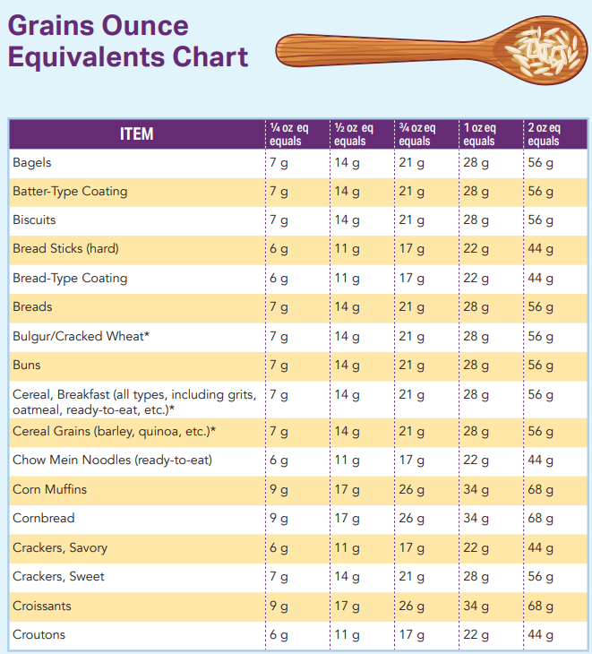
Step 2: Find the item in the grain chart
Use the chart from the USDA resource to identify what type of grain you are trying to calculate for

Slide 54
Step 3: Look at Nutrition Facts and Calculate
Look at Nutrition Facts label of the grain item and find the serving size
Find the number of items or pieces in one serving
Divide the weight (grams) of one serving by the number of items in one serving
Divide weight of required ounce equivalent(s) by weight per item
If answer ends in a fraction or decimal, round up to next whole number

Slide 55
Calculating Grains: example
What is the requirement?
Example
How much ounce equivalent of grains are needed to meet the requirement?
Serving pita bread to 5-year-old at lunch
  ½ ounce equivalent needed
All meals/snacks | 1-2 | 3-5 | 6+
Bread | ½ oz eq | ½ oz eq | ½ oz eq
Bread products | ½ oz eq | ½ oz eq | ½ oz eq

Slide 56
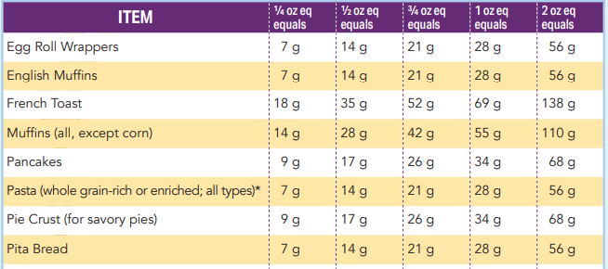
Calculating Grains: example
Step 2: Find the grain item in the chart from USDA
Will need 14g of pita bread to get ½ oz eq

Slide 57
Calculating Grains: Step 3
One serving: 37g
Number of items per serving: 1 items
Weight of serving by number of items:
  37g/1items= 37 grams per item
Divide weight of required oz eq (from chart) by weight per item:
  14g/37g per item= .38 items
Round up to nearest whole number:
  1 whole item

Slide 58
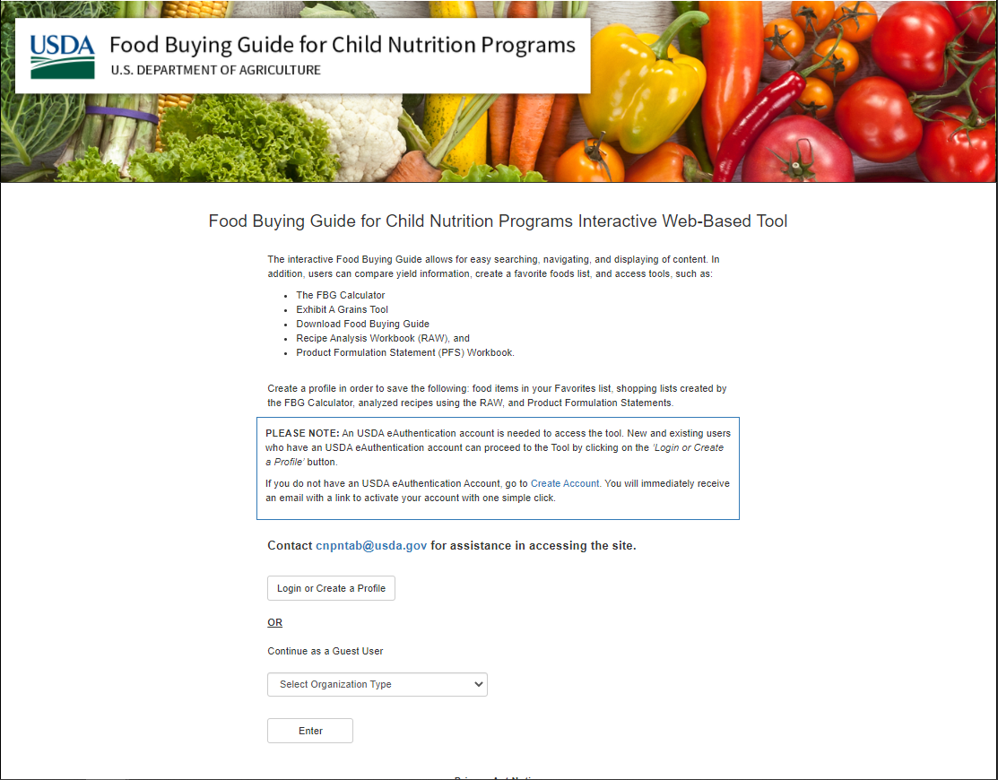
Exhibit A Grain Tool
USDA Food Buying Guide (FBG)
  https://foodbuyingguide.fns.usda.gov/
Can create a profile to save entries, or enter as a guest

Slide 59
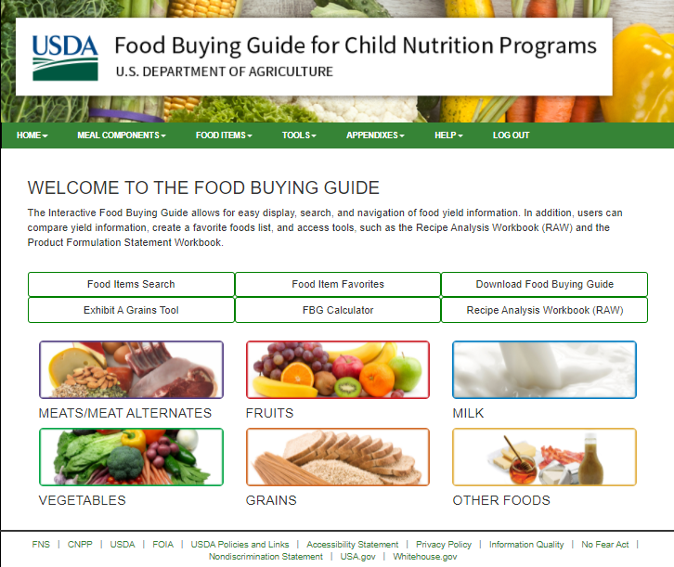
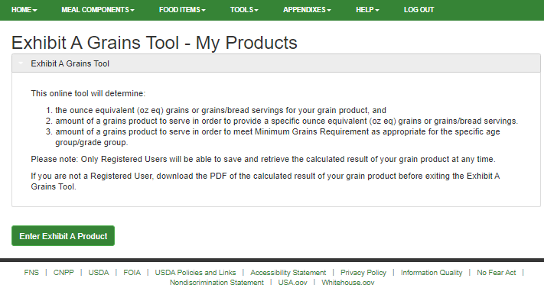
Exhibit A Grains Tool

Slide 60
Exhibit A Grains Tool
The tool has extensive instructions (including a step-by-step video) to explain how to enter in items, and use the tool to calculate the amount to serve
Note: this tool will provide you with fractions of servings to get to the minimum ounce equivalent (may be less than what you calculate using other method)

Slide 61
Questions
04
Notes:
https://survey.alchemer.com/s3/6608825/FY22-CACFP-Ounce-Equivalents

Slide 62
Survey link
Please use this link to access your certificate of training completion survey: https://survey.alchemer.com/s3/6608825/FY22-CACFP-Ounce-Equivalents

Slide 63




THANK YOU
Shannon Raymond, MPH
Training Coordinator
781.338.6471
Shannon.Raymond@mass.gov
www.doe.mass.edu
75 Pleasant Street, Malden, MA 02148
Notes:
SR: Thank you

