Slide 1
Welcome to CACFP Ounce Equivalents in Recipes Training
To access a recording of this presentation, please use this link: https://us02web.zoom.us/rec/share/uc_0DKnFRlqcbdkLi6MF0rRcV7zsAJI7tEvfyfpoeehtjsrrezoy6CuVFt0di_8k.QVIBnkYYV9X5Dvfj

Slide 2
Determining Oz Eq of Grains in Recipes Worksheet
FY22 CACFP Training

Slide 3
Current USDA nondiscrimination statement
In accordance with Federal civil rights law and U.S. Department of Agriculture (USDA) civil rights regulations and policies, the USDA, its Agencies, offices, and employees, and institutions participating in or administering USDA programs are prohibited from discriminating based on race, color, national origin, sex, disability, age, or reprisal or retaliation for prior civil rights activity in any program or activity conducted or funded by USDA.
Persons with disabilities who require alternative means of communication for program information (e.g. Braille, large print, audiotape, American Sign Language, etc.), should contact the Agency (State or local) where they applied for benefits. Individuals who are deaf, hard of hearing or have speech disabilities may contact USDA through the Federal Relay Service at (800) 877-8339. Additionally, program information may be made available in languages other than English.
To file a program complaint of discrimination, complete the USDA Program Discrimination Complaint Form, (AD-3027) found online at: How to File a Complaint, and at any USDA office, or write a letter addressed to USDA and provide in the letter all of the information requested in the form. To request a copy of the complaint form, call (866) 632-9992. Submit your completed form or letter to USDA by:
(1) mail: U.S. Department of Agriculture
Office of the Assistant Secretary for Civil Rights
1400 Independence Avenue, SW
Washington, D.C. 20250-9410;
(2) fax: (202) 690-7442; or
(3) email: program.intake@usda.gov.
This institution is an equal opportunity provider.
3

Slide 4
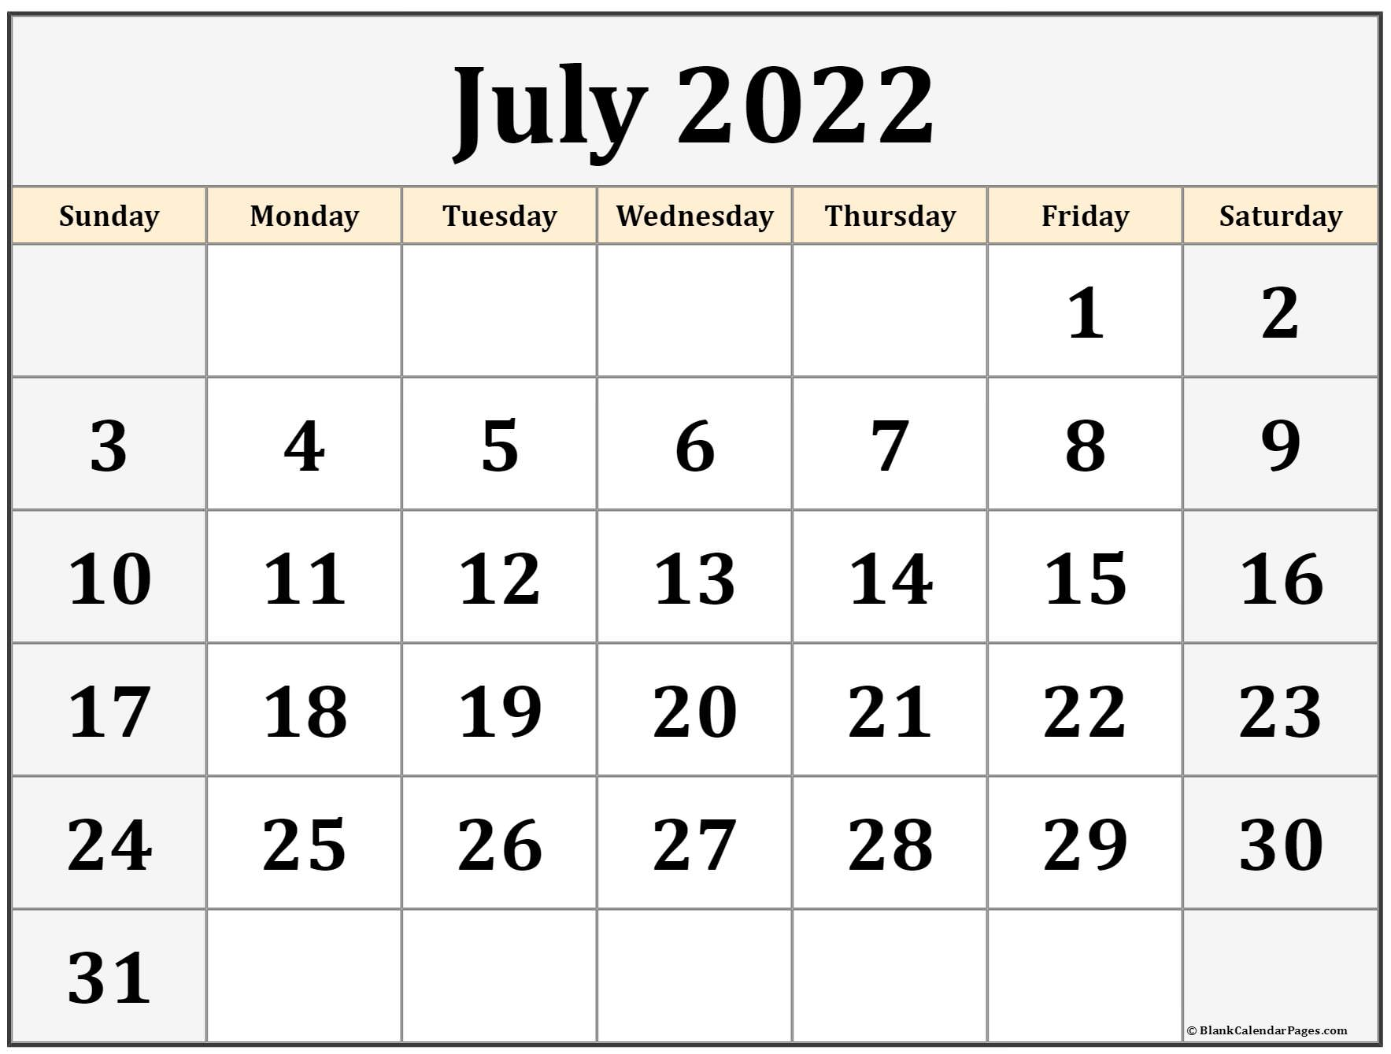
Ounce Equivalents Implementation
USDA has extended a waiver to delay the implementation of ounce equivalents for grains in the CACFP through June 30, 2022
Starting on July 1, 2022, CACFP programs are expected to begin utilizing ounce equivalents for grains
The Document and Reference Library has all previous oz eq trainings

Slide 5
Goal for today
Identify how to determine the ounce equivalents of grains in a self-prepared item
Walk through the process for determining Ounce Equivalents for Grains in recipe worksheet
How to use this form
Examples

Slide 6
When will calculating ounce equivalents of grains in a recipe be necessary?
01

Slide 7
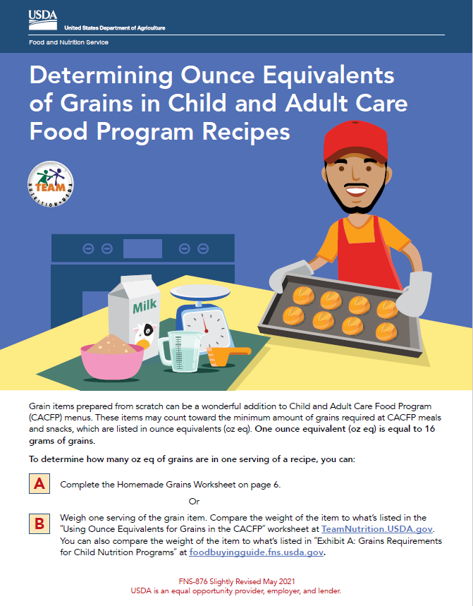
Determining oz eq of grains in a recipe
Scratch made grains items are a fantastic addition to CACFP menus
These items can count towards the grain component for a meal or snack
Programs will need to calculate grains in a recipe, and determine the appropriate serving for an individual

Slide 8
Using the Determining Ounce Equivalents of Grains in Recipes Worksheet
02

Slide 9
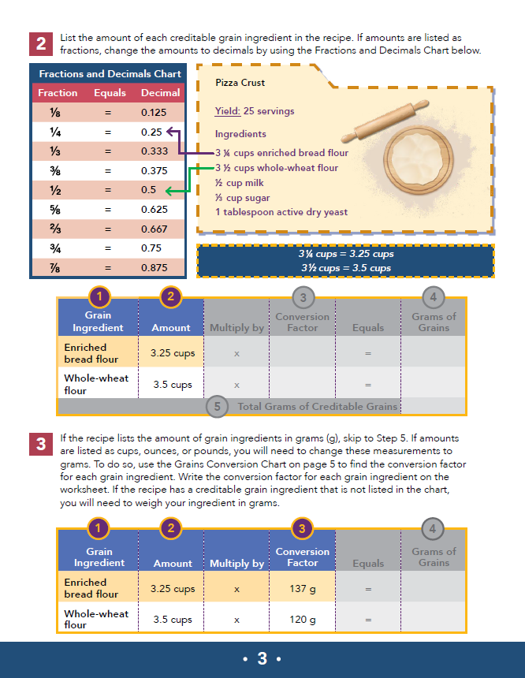
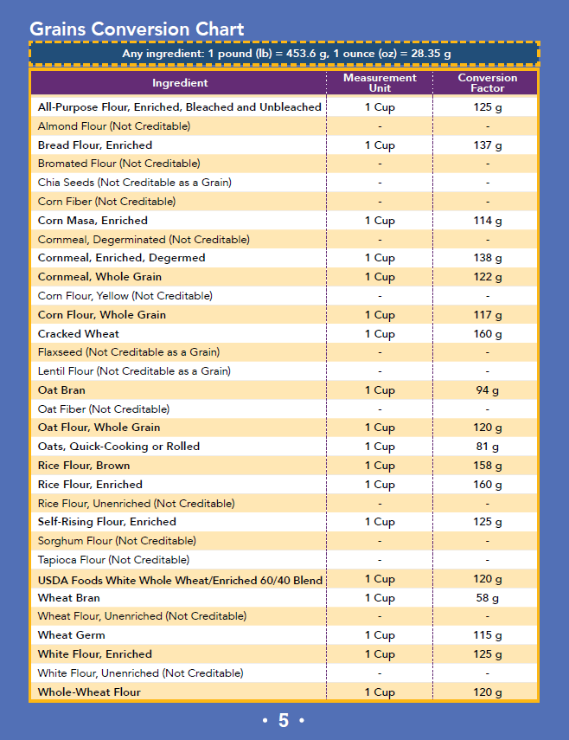
The USDA Oz Eq in Recipes Worksheet
See chat for a copy of this worksheet

Slide 10
Using the worksheet
This worksheet will be useful for commonly prepared grains items made at your center/home.
Review your recipes, identify the amount to be served in ounce equivalents, and keep it with your documentation for your menu planning and shopping
You won’t have to think about it each time

Slide 11
Homemade grains worksheet
Grain Ingredient | Amount |  | Conversion Factor |  | Grams of Grains
 |  | x |  | =
 |  | x |  | =
 |  | x |  | =
 |  | x |  | =
Total Grams of Creditable Grains |  |  |  | =
This worksheet will help to calculate the creditable grains in a recipe

Slide 12
Using the ounce equivalents worksheet
Identify creditable grains
List each creditable grain ingredient in the recipe
List amount of each creditable grain
If amounts are listed as fractions, change to decimals
If amounts of grains are listed in cups/ounces/pounds, change these measurements to grams
If amounts are listed in grams (g), skip to next step
Multiply amount of creditable grain by the conversion factor
If item has been weighed, enter weight in final column
Add all grams of creditable grains ingredients to determine total grams of grains in recipe
Divide total grams of grains by number of servings (yield)
Divide grams per serving by 16 grams
If this ends in a decimal, round the number down to the nearest 0.25oz

Slide 13
Step 1: What are the creditable grain ingredients?
Review the recipe and identify all the creditable grain ingredients
Use chart in worksheet to help identify commonly used grain ingredients
Grain Ingredient | Amount |  | Conversion Factor |  | Grams of Grains
 |  | x |  | =
 |  | x |  | =
 |  | x |  | =
 |  | x |  | =
Total Grams of Creditable Grains |  |  |  | =

Slide 14
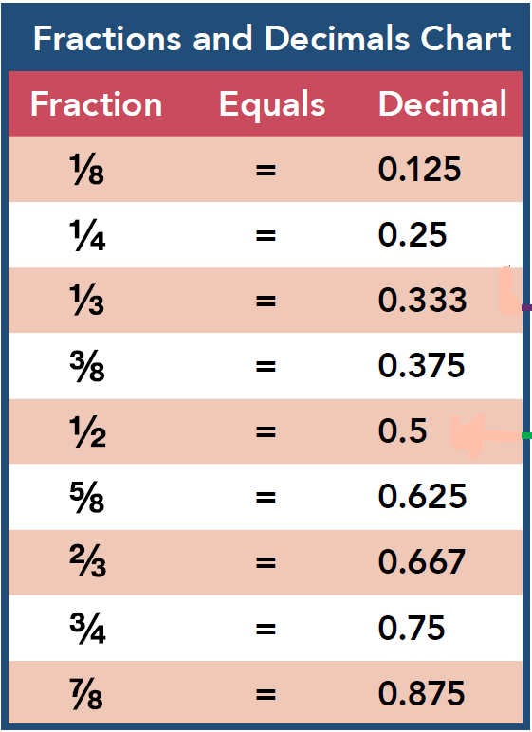
Step 2: Identify amount of grain ingredients
Identify how much of each grain ingredient is used in the recipe
If amounts are provided in fractions, convert to a decimal

Slide 15
Step 3: Conversion factor
Use the chart from the worksheet to identify the conversion factor for each grain ingredient
If your grains are already listed in grams in the recipe, you can skip this step

Slide 16
Step 4: Multiply
Multiply the amount of the grain ingredient by the conversion factor to determine the grams of grain ingredient
If you have weighed the ingredient, enter that weight under the “Grams of Grains” column
Grain Ingredient | Amount |  | Conversion Factor |  | Grams of Grains
 |  | x |  | =
 |  | x |  | =
Total Grams of Creditable Grains |  |  |  | =

Slide 17
Step 5: Sum
Add all the grams of creditable grain ingredients together to determine the total grams of grains in the recipe
Grain Ingredient | Amount |  | Conversion Factor |  | Grams of Grains
 |  | x |  | =
 |  | x |  | =
Total Grams of Creditable Grains |  |  |  | =

Slide 18
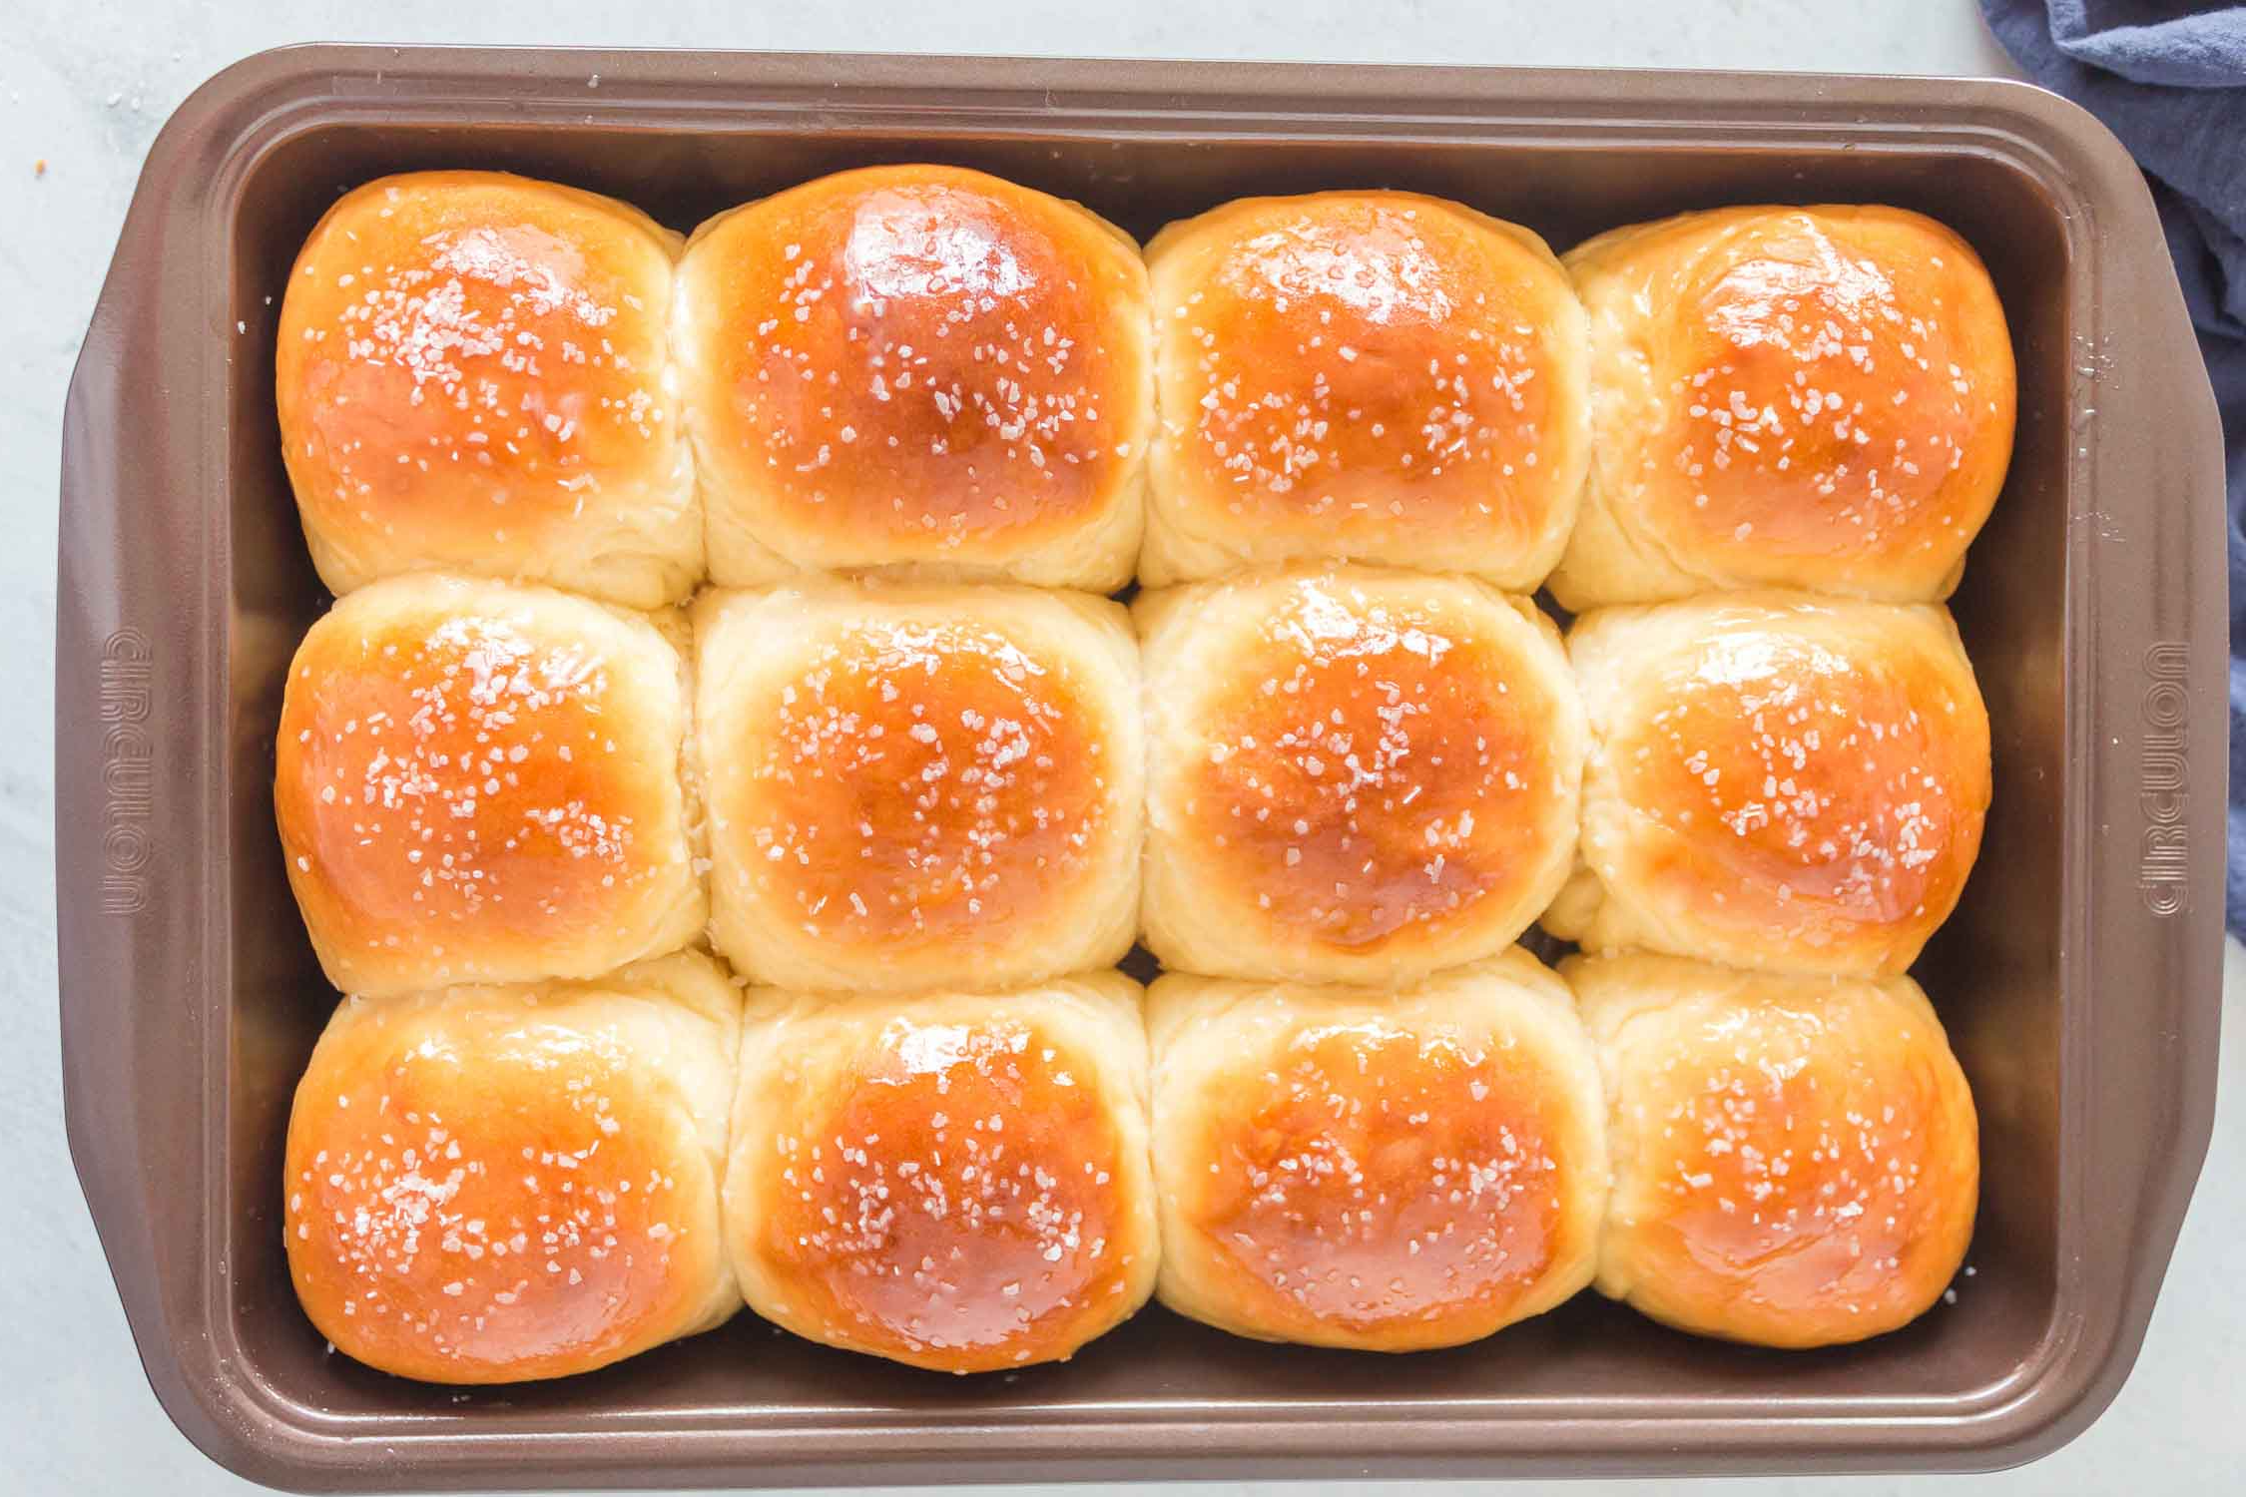
Step 6: Identify grams per serving
Divide the total grams of creditable grains (from the last step) by the number of servings, or yield, from the recipe
This tells you the amount of grains per serving

Slide 19
Steps 7 & 8: Divide by 16 grams, and rounding
Divide the total number of grams of creditable grains by 16 grams
This will tell you how many ounce equivalents of grains are in each serving
If the answer from the previous step ends in a decimal, round down to the nearest 0.25oz eq of grains
Review ounce equivalents table to determine amount needed for age group/meal service
Age group | Meal | Minimum Amount of Grains Required
Ages 1-5 | Breakfast Lunch/Supper Snack | ½ ounce equivalent
Ages 6-18 | Breakfast Lunch/Supper Snack | 1 ounce equivalent
Adults | Snack | 1 ounce equivalent
Adults | Breakfast Lunch/Supper | 2 ounce equivalents

Slide 20
Examples
03

Slide 21
Example 1: Granola
FNP’s Outside School Hours Center is preparing granola to serve with breakfast for their participants over school vacation
Using the recipe, we need to identify the ounce equivalents of grains served in this recipe
Recipe:
3 ½ cups rolled oats
¼ cup brown sugar
½ teaspoon salt
¼ teaspoon cinnamon
1/3 cup coconut oil
1/3 cup honey
4 teaspoons vanilla extract
Serving: ¼ cup per participant (using old grains serving sizes)
Yield: 5 cups
Total number of servings per batch: 20

Slide 22
Step 1: What are the creditable grain ingredients?
Review the recipe and identify all the creditable grain ingredients
Rolled oats is the only grain ingredient in this recipe
Recipe:
3 ½ cups rolled oats
¼ cup brown sugar
½ teaspoon salt
¼ teaspoon cinnamon
1/3 cup coconut oil
1/3 cup honey
4 teaspoons vanilla extract
Serving: ¼ cup per participant (using old grains serving sizes)
Yield: 5 cups
Total number of servings per batch: 20

Slide 23
Step 1: What are the creditable grain ingredients?
Grain Ingredient | Amount |  | Conversion Factor |  | Grams of Grains
Rolled oats |  | x |  | =
 |  | x |  | =
 |  | x |  | =
 |  | x |  | =
Total Grams of Creditable Grains |  |  |  | =

Slide 24
Step 2: Identify amount of grain ingredients
Identify how much of each grain ingredient is used in the recipe
If amounts are provided in fractions, convert to a decimal
3 ½ cups= 3.5 cups
Recipe:
3 ½ cups rolled oats
¼ cup brown sugar
½ teaspoon salt
¼ teaspoon cinnamon
1/3 cup coconut oil
1/3 cup honey
4 teaspoons vanilla extract
Serving: ¼ cup per participant
Yield: 5 cups
Total number of servings per batch: 20

Slide 25
Step 2: Identify amount of grain ingredients
Grain Ingredient | Amount |  | Conversion Factor |  | Grams of Grains
Rolled oats | 3.5 cups | x |  | =
 |  | x |  | =
 |  | x |  | =
 |  | x |  | =
Total Grams of Creditable Grains |  |  |  | =

Slide 26
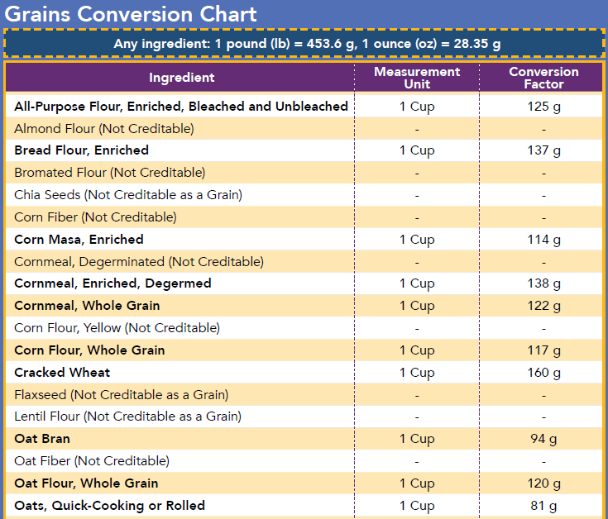
Step 3: Conversion factor
Use the chart from the worksheet to identify the conversion factor for each grain ingredient
Rolled oats have a conversion factor of:
1 cup=81g

Slide 27
Step 3: Conversion factor
Grain Ingredient | Amount |  | Conversion Factor |  | Grams of Grains
Rolled oats | 3.5 cups | x | 81 grams | =
 |  | x |  | =
 |  | x |  | =
 |  | x |  | =
Total Grams of Creditable Grains |  |  |  | =

Slide 28
Step 4: Multiply
Multiply the amount of the grain ingredient by the conversion factor to determine the grams of grain ingredient
If you have weighed the ingredient, enter that weight under the “Grams of Grains” column
Grain Ingredient | Amount |  | Conversion Factor |  | Grams of Grains
Rolled oats | 3.5 cups | x | 81 grams | = | 283.5 grams
 |  | x |  | =
Total Grams of Creditable Grains |  |  |  | =

Slide 29
Step 5: Sum
Add all the grams of creditable grain ingredients together to determine the total grams of grains in the recipe
Grain Ingredient | Amount |  | Conversion Factor |  | Grams of Grains
Rolled oats | 3.5 cups | x | 81 grams | = | 283.5 grams
 |  | x |  | =
Total Grams of Creditable Grains |  |  |  | = | 283.5 grams

Slide 30
Step 6: Identify grams per serving
Recipe:
3 ½ cups rolled oats
¼ cup brown sugar
½ teaspoon salt
¼ teaspoon cinnamon
1/3 cup coconut oil
1/3 cup honey
4 teaspoons vanilla extract
Serving: ¼ cup per participant (using old grains serving sizes)
Yield: 5 cups
Total number of servings per batch: 20
Divide the total grams of creditable grains (from the last step) by the number of servings, or yield, from the recipe
283.5 grams/20 servings= 14.175 grams
This tells you the amount of grains per serving

Slide 31
Steps 7 & 8: Divide by 16 grams, and rounding
Divide the total number of grams of creditable grains by 16 grams
14.175 grams/16 grams= 0.886
If the answer from the previous step ends in a decimal, round down to the nearest 0.25oz eq of grains
0.886 rounds down to 0.75
One serving of granola provides 0.75oz eq of grains
Determine number of servings needed based on age of participant
Age group | Meal | Minimum Amount of Grains Required
Ages 1-5 | Breakfast Lunch/Supper Snack | ½ ounce equivalent
Ages 6-18 | Breakfast Lunch/Supper Snack | 1 ounce equivalent
Adults | Snack | 1 ounce equivalent
Adults | Breakfast Lunch/Supper | 2 ounce equivalents

Slide 32
Steps 7 & 8: Divide by 16 grams, and rounding
One serving of granola provides 0.75oz eq of grains
Minimum requirement is 1 oz eq
Would need to offer at least 1 1/3 servings to meet 1 oz eq
1 1/3 serving x ¼ cup= ~0.333 cup (1/3 cup)
Age group | Meal | Minimum Amount of Grains Required
Ages 1-5 | Breakfast Lunch/Supper Snack | ½ ounce equivalent
Ages 6-18 | Breakfast Lunch/Supper Snack | 1 ounce equivalent
Adults | Snack | 1 ounce equivalent
Adults | Breakfast Lunch/Supper | 2 ounce equivalents

Slide 33

Example 2: Cornbread
DESE’s Childcare Center is preparing cornbread to serve with lunch of grilled chicken, mashed potatoes, and grilled asparagus.
Using the recipe, we need to identify the ounce equivalents of grains served in this recipe
Recipe:
¾ cup enriched flour
1 cup whole yellow cornmeal
1 ½ teaspoon baking powder
½ teaspoon baking soda
½ teaspoon salt
2 tablespoons sugar
1 ½ cup buttermilk
2 eggs, slightly beaten
Total number of servings per batch: 9

Slide 34
Step 1: What are the creditable grain ingredients?
Review the recipe and identify all the creditable grain ingredients
What is/are the grain ingredient(s)?
Use chat to enter answer
Recipe:
¾ cup enriched flour
1 cup whole yellow cornmeal
1 ½ teaspoon baking powder
½ teaspoon baking soda
½ teaspoon salt
2 tablespoons sugar
1 ½ cup buttermilk
2 eggs, slightly beaten
Total number of servings per batch: 9

Slide 35
Step 1: What are the creditable grain ingredients?
Grain Ingredient | Amount |  | Conversion Factor |  | Grams of Grains
Enriched flour |  | x |  | =
Whole yellow cornmeal |  | x |  | =
 |  | x |  | =
 |  | x |  | =
Total Grams of Creditable Grains |  |  |  | =

Slide 36
Step 2: Identify amount of grain ingredients
Identify how much of each grain ingredient is used in the recipe
If amounts are provided in fractions, convert to a decimal
¾ cups= 0.75 cups
Recipe:
¾ cup enriched flour
1 cup whole yellow cornmeal
1 ½ teaspoon baking powder
½ teaspoon baking soda
½ teaspoon salt
2 tablespoons sugar
1 ½ cup buttermilk
2 eggs, slightly beaten
Total number of servings per batch: 9

Slide 37
Step 2: Identify amount of grain ingredients
Grain Ingredient | Amount |  | Conversion Factor |  | Grams of Grains
Enriched flour | 0.75 cups | x |  | =
Whole yellow cornmeal | 1.0 cups | x |  | =
 |  | x |  | =
 |  | x |  | =
Total Grams of Creditable Grains |  |  |  | =

Slide 38
Step 3: Conversion factor
Use the chart from the worksheet to identify the conversion factor for each grain ingredient
Enriched flour has a conversion factor of:
1 cup= 125 g
Whole yellow cornmeal has a conversion factor of:
1 cup=122 g

Slide 39
Step 3: Conversion factor
Grain Ingredient | Amount |  | Conversion Factor |  | Grams of Grains
Enriched flour | 0.75 cups | x | 125 g | =
Whole yellow cornmeal | 1.0 cups | x | 122 g | =
 |  | x |  | =
 |  | x |  | =
Total Grams of Creditable Grains |  |  |  | =

Slide 40
Step 4: Multiply
Multiply the amount of the grain ingredient by the conversion factor to determine the grams of grain ingredient
If you have weighed the ingredient, enter that weight under the “Grams of Grains” column
Grain Ingredient | Amount |  | Conversion Factor |  | Grams of Grains
Enriched flour | 0.75 cups | x | 125 g | = | 93.75 grams
Whole yellow cornmeal | 1.0 cups | x | 122 g | = | 122 grams
Total Grams of Creditable Grains |  |  |  | =

Slide 41
Step 5: Sum
Add all the grams of creditable grain ingredients together to determine the total grams of grains in the recipe
Grain Ingredient | Amount |  | Conversion Factor |  | Grams of Grains
Enriched flour | 0.75 cups | x | 125 g | = | 93.75 grams
Whole yellow cornmeal | 1.0 cups | x | 122 g | = | 122 grams
Total Grams of Creditable Grains |  |  |  | = | 215.75 grams

Slide 42
Step 6: Identify grams per serving
Recipe:
¾ cup enriched flour
1 cup whole yellow cornmeal
1 ½ teaspoon baking powder
½ teaspoon baking soda
½ teaspoon salt
2 tablespoons sugar
1 ½ cup buttermilk
2 eggs, slightly beaten
Total number of servings per batch: 9
Divide the total grams of creditable grains (from the last step) by the number of servings, or yield, from the recipe
215.75 grams/9 servings= 23.97 grams
This tells you the amount of grains per serving

Slide 43
Steps 7 & 8: Divide by 16 grams, and rounding
Divide the total number of grams of creditable grains by 16 grams
23.97 grams/16 grams= 1.49
If the answer from the previous step ends in a decimal, round down to the nearest 0.25oz eq of grains
1.49 rounds down to 1.25
One piece of cornbread provides 1.25oz eq of grains
Determine number of servings needed based on age of participant
Age group | Meal | Minimum Amount of Grains Required
Ages 1-5 | Breakfast Lunch/Supper Snack | ½ ounce equivalent
Ages 6-18 | Breakfast Lunch/Supper Snack | 1 ounce equivalent
Adults | Snack | 1 ounce equivalent
Adults | Breakfast Lunch/Supper | 2 ounce equivalents

Slide 44
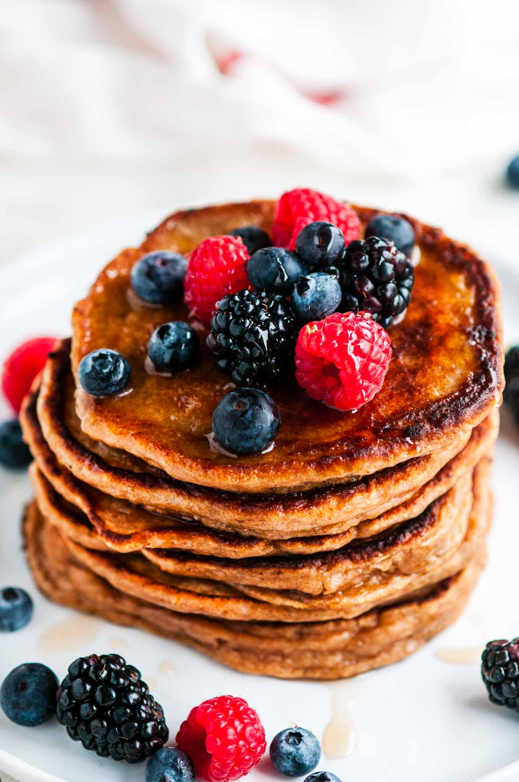
Example 3: Pancakes
DESE’s ADH Center is making whole wheat pancakes to serve with breakfast
Using the recipe, we need to identify the ounce equivalents of grains served in this recipe
Recipe:
6tbs butter
3 1/3 cup whole wheat flour
6 tsp baking powder
1 ½ tsp salt
1 tsp cinnamon
½ tsp nutmeg
1 tbsp sugar
2 ½ cup milk
2 tsp vanilla extract
3 egg
Makes 32 pancakes

Slide 45
Step 1: What are the creditable grain ingredients?
Review the recipe and identify all the creditable grain ingredients
What is/are the grain ingredient(s)?
Use chat to enter answer
Recipe:
6tbs butter
3 1/3 cup whole wheat flour
6 tsp baking powder
1 ½ tsp salt
1 tsp cinnamon
½ tsp nutmeg
1 tbsp sugar
2 ½ cup milk
2 tsp vanilla extract
3 egg
Makes 32 pancakes

Slide 46
Step 1: What are the creditable grain ingredients?
Grain Ingredient | Amount |  | Conversion Factor |  | Grams of Grains
Whole wheat flour |  | x |  | =
 |  | x |  | =
 |  | x |  | =
 |  | x |  | =
Total Grams of Creditable Grains |  |  |  | =

Slide 47
Step 2: Identify amount of grain ingredients
Identify how much of each grain ingredient is used in the recipe
If amounts are provided in fractions, convert to a decimal
3 1/3 cups= 3.33 cups
Recipe:
6tbs butter
3 1/3 cup whole wheat flour
6 tsp baking powder
1 ½ tsp salt
1 tsp cinnamon
½ tsp nutmeg
1 tbsp sugar
2 ½ cup milk
2 tsp vanilla extract
3 egg
Makes 32 pancakes

Slide 48
Step 2: Identify amount of grain ingredients
Grain Ingredient | Amount |  | Conversion Factor |  | Grams of Grains
Whole wheat flour | 3.33 cups | x |  | =
 |  | x |  | =
 |  | x |  | =
 |  | x |  | =
Total Grams of Creditable Grains |  |  |  | =

Slide 49
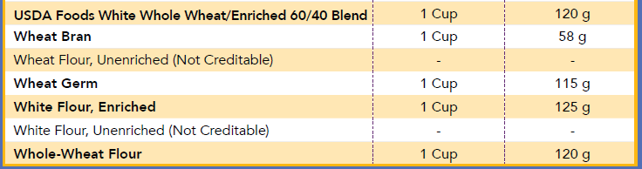
Step 3: Conversion factor
Use the chart from the worksheet to identify the conversion factor for each grain ingredient
Whole wheat flour has a conversion factor of:
1 cup= 120 g

Slide 50
Step 3: Conversion factor
Grain Ingredient | Amount |  | Conversion Factor |  | Grams of Grains
Whole wheat flour | 3.33 cups | x | 120 g | =
 |  | x |  | =
 |  | x |  | =
 |  | x |  | =
Total Grams of Creditable Grains |  |  |  | =

Slide 51
Step 4: Multiply
Multiply the amount of the grain ingredient by the conversion factor to determine the grams of grain ingredient
If you have weighed the ingredient, enter that weight under the “Grams of Grains” column
Grain Ingredient | Amount |  | Conversion Factor |  | Grams of Grains
Whole wheat flour | 3.33 cups | x | 120 g | =
Total Grams of Creditable Grains |  |  |  | =

Slide 52
Step 4: Multiply
Multiply the amount of the grain ingredient by the conversion factor to determine the grams of grain ingredient
If you have weighed the ingredient, enter that weight under the “Grams of Grains” column
Grain Ingredient | Amount |  | Conversion Factor |  | Grams of Grains
Whole wheat flour | 3.33 cups | x | 120 g | = | 399.6 grams
Total Grams of Creditable Grains |  |  |  | =

Slide 53
Step 5: Sum
Add all the grams of creditable grain ingredients together to determine the total grams of grains in the recipe
Grain Ingredient | Amount |  | Conversion Factor |  | Grams of Grains
Whole wheat flour | 3.33 cups | x | 120 g | = | 399.6 grams
Total Grams of Creditable Grains |  |  |  | = | 399.6 grams

Slide 54
Step 6: Identify grams per serving
Recipe:
6tbs butter
3 1/3 cup whole wheat flour
6 tsp baking powder
1 ½ tsp salt
1 tsp cinnamon
½ tsp nutmeg
1 tbsp sugar
2 ½ cup milk
2 tsp vanilla extract
3 egg
Makes 32 pancakes
Divide the total grams of creditable grains (from the last step) by the number of servings, or yield, from the recipe
399.6 grams/32 servings= 12.49
This tells you the amount of grains per serving

Slide 55

Steps 7 & 8: Divide by 16 grams, and rounding
Divide the total number of grams of creditable grains by 16 grams
12.49 grams/16 grams= 0.78
If the answer from the previous step ends in a decimal, round down to the nearest 0.25oz eq of grains
0.78 rounds down to 0.75
One pancake provides 0.75oz eq of grains
How many pancakes must be offered?
Poll question

Slide 56
Steps 7 & 8: Divide by 16 grams, and rounding
One pancake provides 0.75oz eq of grains
Adults need 2 oz eq at breakfast
2 oz eq/ 0.75 oz eq= 2.667 pancakes
Round up to 3 pancakes per participant
Age group | Meal | Minimum Amount of Grains Required
Ages 1-5 | Breakfast Lunch/Supper Snack | ½ ounce equivalent
Ages 6-18 | Breakfast Lunch/Supper Snack | 1 ounce equivalent
Adults | Snack | 1 ounce equivalent
Adults | Breakfast Lunch/Supper | 2 ounce equivalents

Slide 57
Questions
03

Slide 58
Certificate of training completion
Please use this link to access a brief survey and get your certificate of training completion: https://survey.alchemer.com/s3/6738829/FY22-CACFP-Ounce-Equivalents-in-Recipes-Worksheet
Notes:
https://survey.alchemer.com/s3/6738829/FY22-CACFP-Ounce-Equivalents-in-Recipes-Worksheet

Slide 59
CACFP Training Needs
We are still collecting input on what training topics our programs would like to see!
Please take 5 minutes to let me know what training topics of materials would be most beneficial:
https://survey.alchemer.com/s3/6601545/CACFP-FY22-Training-Needs-Assessment
Notes:
https://survey.alchemer.com/s3/6601545/CACFP-FY22-Training-Needs-Assessment

Slide 60
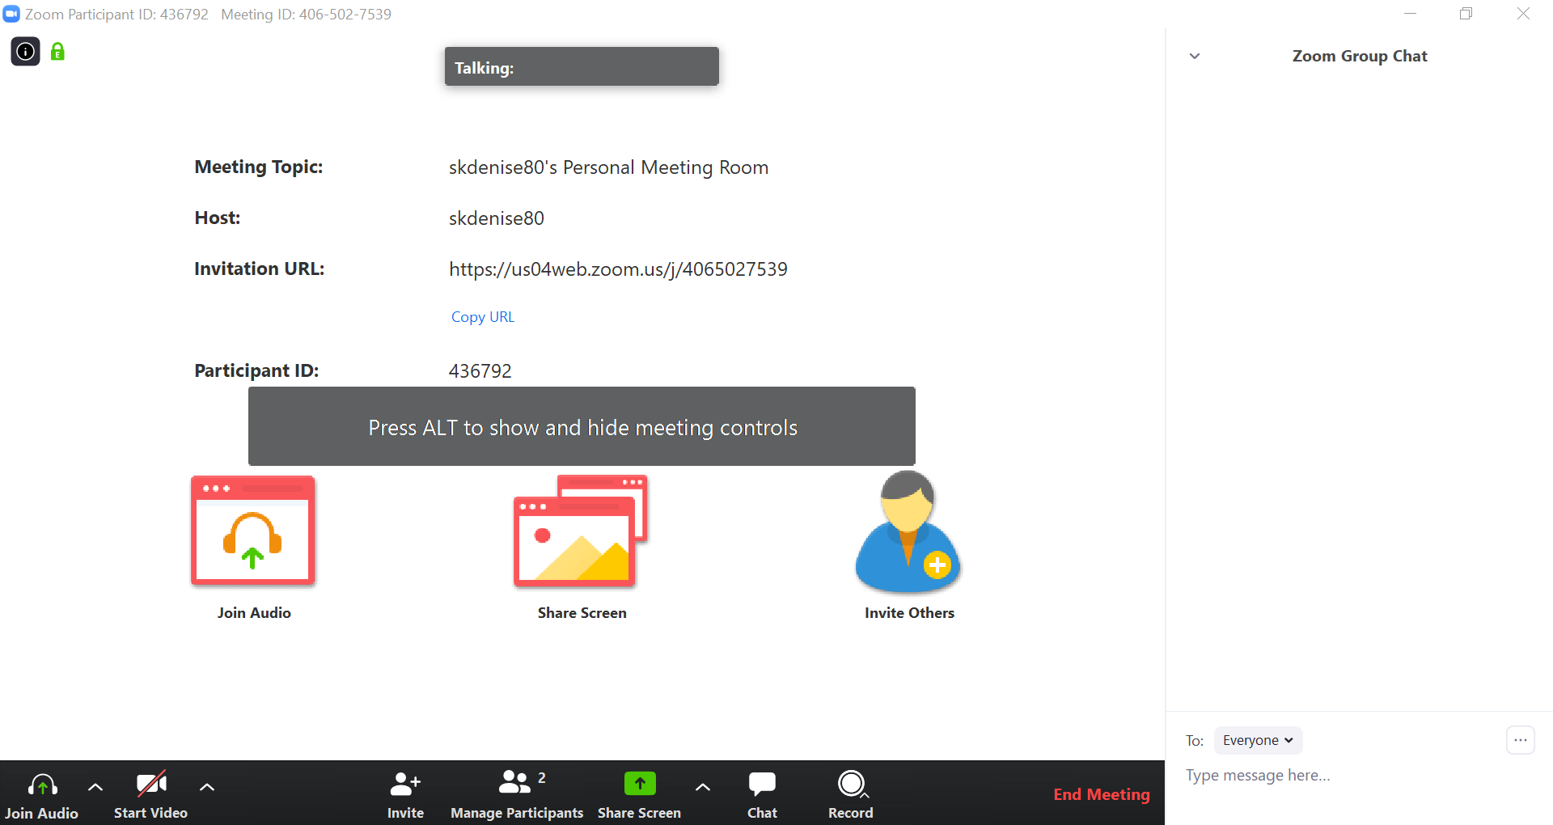
Questions?
Enter your question here
To ask a question open the chat box

Slide 61




THANK YOU
Shannon Raymond, MPH
Training Coordinator
781.338.6471
Shannon.Raymond@mass.gov
www.doe.mass.edu
75 Pleasant Street, Malden, MA 02148
Notes:
SR: Thank you

